Slide 1


Slide 2
October is Down Syndrome Awareness Month.​
​
Today, we are going to be learning all about Down syndrome and how we can all be kind, respectful members of our community.​

Slide 3
Let's take a look at some of the vocabulary that we will be using today...

Slide 4

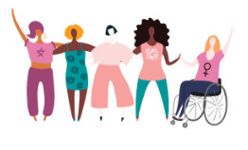
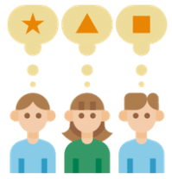


​
Difference
​
Inclusion
Respect

Slide 5
Key Vocabulary​
​
Difference: When things are not exactly the same.​
​
Inclusion: Making sure everyone is included and has the same opportunities.
Respect: Treating people kindly and fairly.

Slide 6
We are also going to be thinking about some of our British Values today:​
​
Mutual Respect​
Tolerance

Slide 7
Tolerance:
Accepting differences and celebrating differences.
Mutual Respect:
Treating everyone kindly and fairly, no matter who they are.

Slide 8

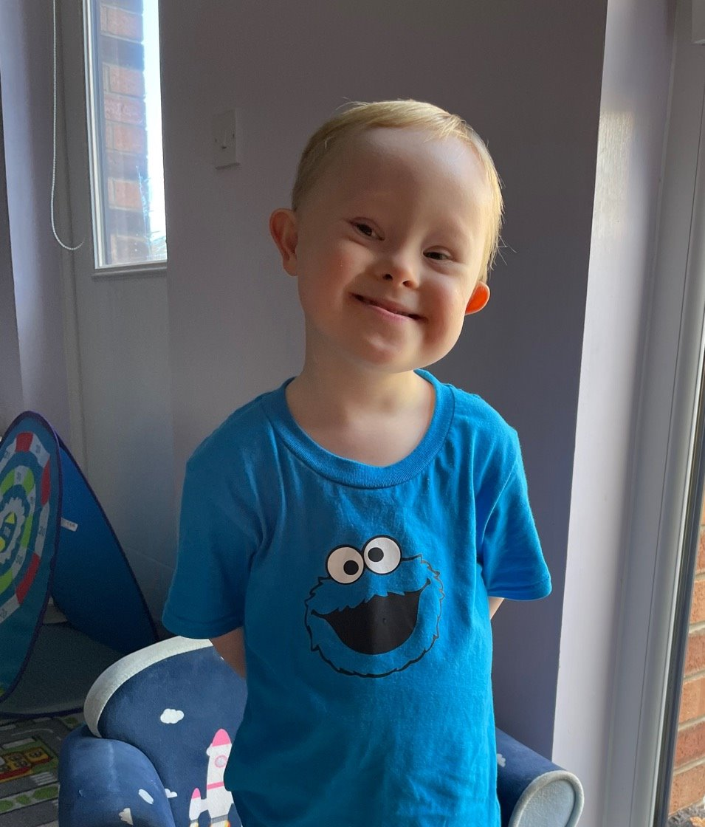


Have you ever heard of Down syndrome?

Slide 9
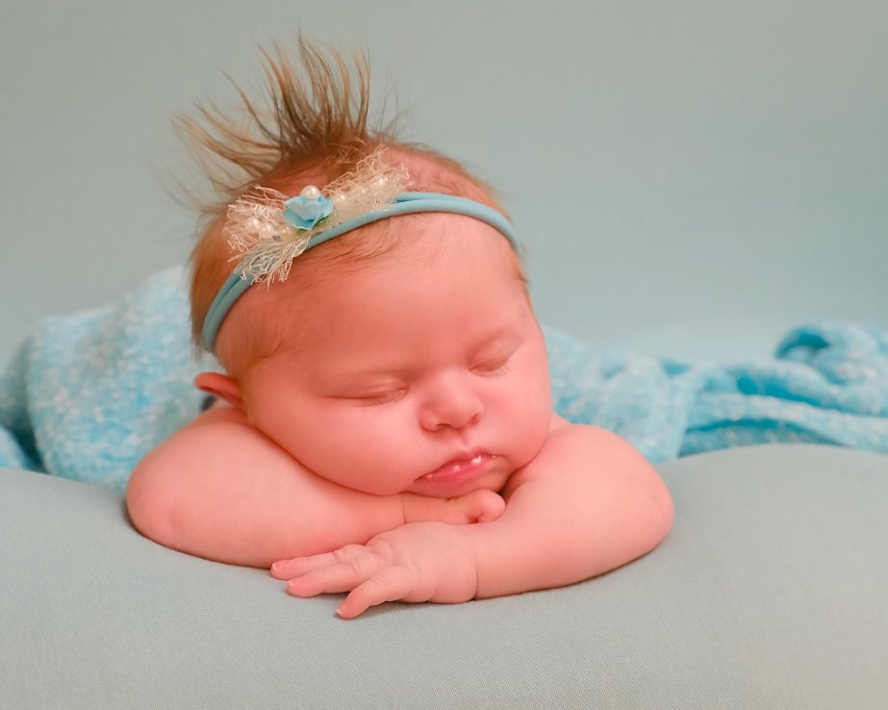
What is Down syndrome?
People are born with Down syndrome. It
is not an illness and you cannot catch it like a cold.

Slide 10
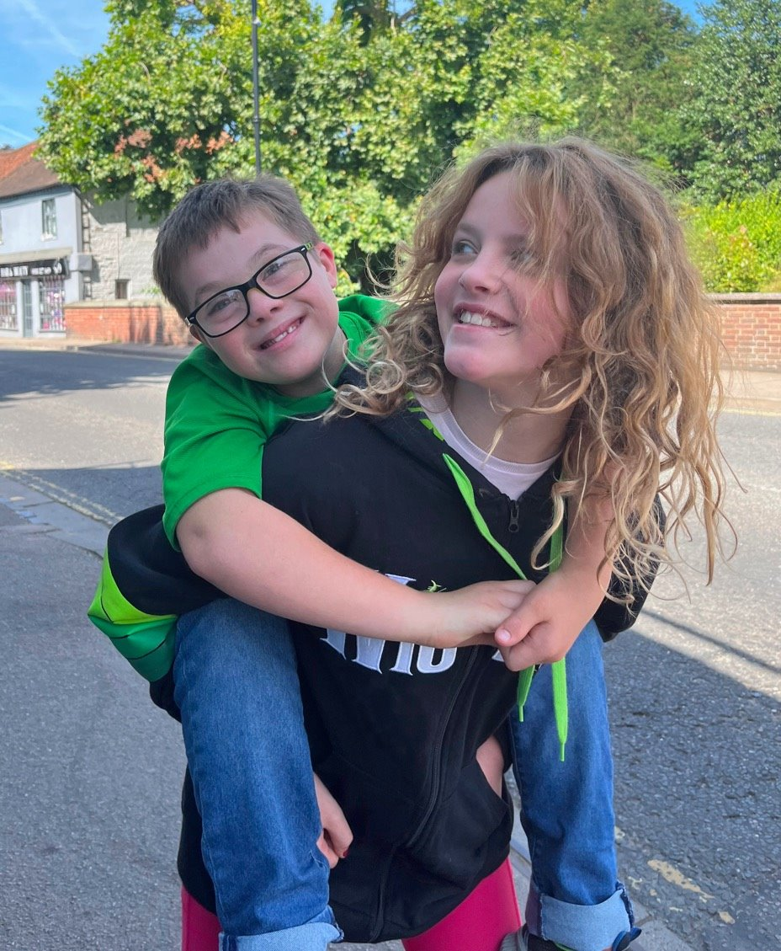
Children with Down syndrome share some physical characteristics...
but look more like their families than each other.

Slide 11
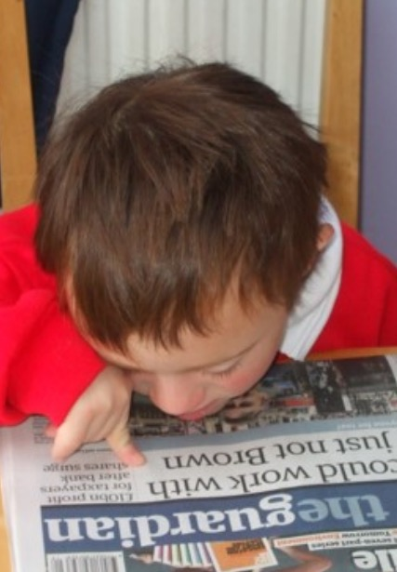
It may take children with Down syndrome longer to learn some things. They might need some extra practice or support.

Slide 12
Can you always do something straight away? Can you think of a time you needed extra help or time?

Slide 13
How does it feel when it is tricky to do something? How can other people help at times like this?

Slide 14
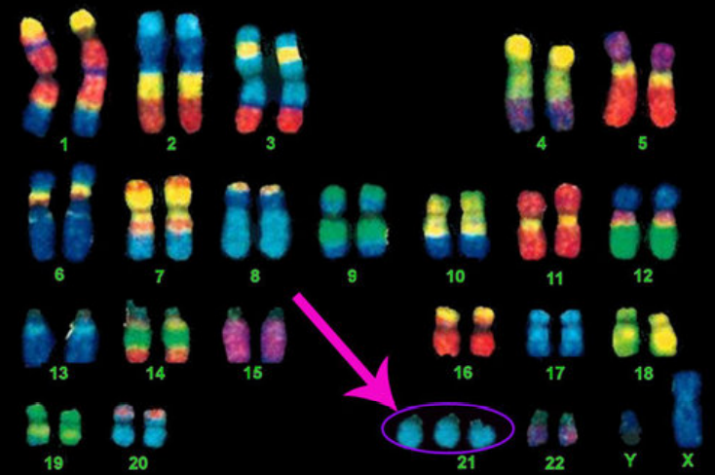
There are things in our body called chromosomes and they decide on things like what colour eyes you have.
Down syndrome is caused by an extra chromosome.
Having Down syndrome is just one part of a person – just like eye colour.

Slide 15
Because these look like colourful socks, this is why people often wear bright, colourful socks to raise awareness about Down syndrome.

Slide 16
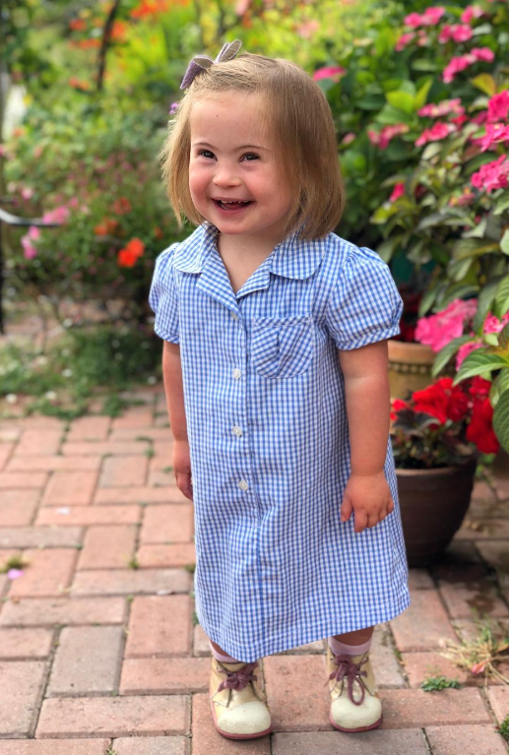
Children with Down syndrome:
Are good at some things and have to work really hard at others – just like all children.

Slide 17
Children with Down syndrome:
Have likes and dislikes – just like all children.

Slide 18
Children with Down syndrome:
Have wants, hopes, dreams and feelings - just like all children.

Slide 19
Children with Down syndrome:
Want to be included and treated with kindness – just like all children.

Slide 20
Children with Down syndrome:
Are all individuals – just like all children.

Slide 21
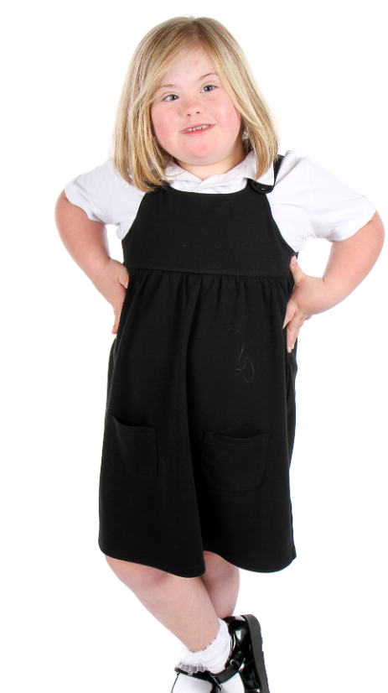
https://www.youtube.com/watch?v=_r_2rmDYfz4
Let's watch a video to find out a little bit more about Down syndrome.

Slide 22
What have we learnt about Down syndrome so far?

Slide 23





What different ways can you think of to communicate?

Slide 24
Children with Down syndrome may use actions (signs) alongside words to help them communicate. ​
Do you know any actions or signs?
Can you think of any songs that use actions or signs?
​

Slide 25
Why might it be helpful if everyone knew some signs?

Slide 26
True or False Activity

Slide 27
We are going to look at some statements about Down syndrome.
You need to think about whether they are true or false.
Go and stand by the true or false signs put up in the classroom.

Slide 28
Children with Down syndrome can’t go to school.

Slide 29
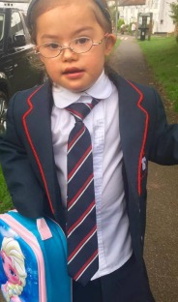
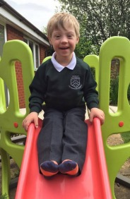
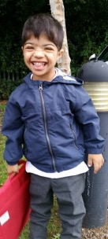
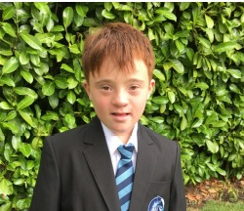
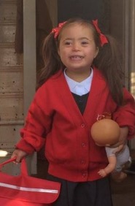
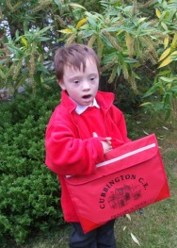
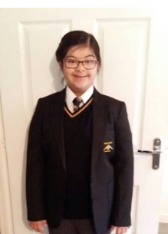
Children with Down syndrome can’t go to school.
False
Children with Down syndrome enjoy going to school.

Slide 30
Children with Down syndrome are always happy.

Slide 31
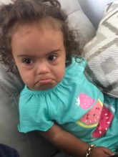
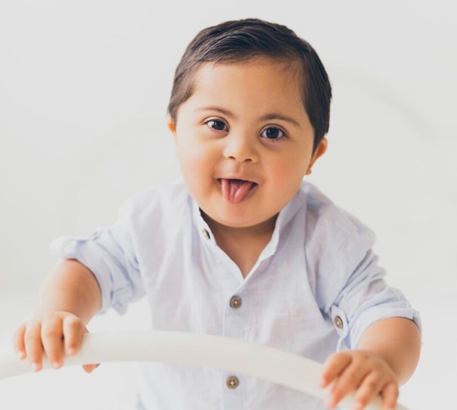
Children with Down syndrome are always happy.
False
Children with Down syndrome experience all emotions - just like you do!

Slide 32
People with Down syndrome can get a job.

Slide 33
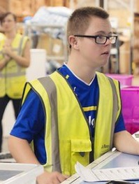
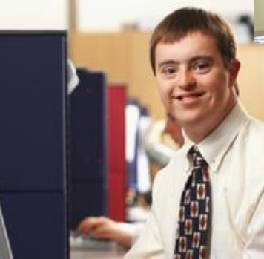
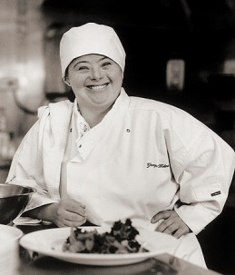

People with Down syndrome can get a job.
Absolutely!
People with Down syndrome enjoy working in a variety of roles.

Slide 34
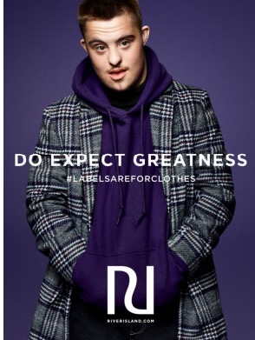
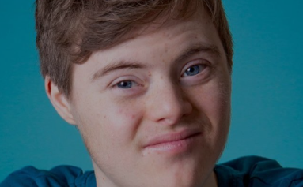
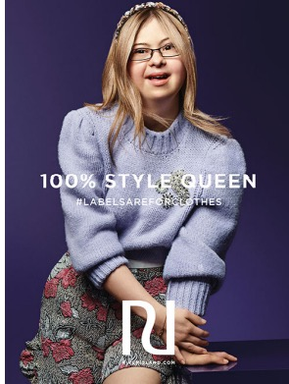
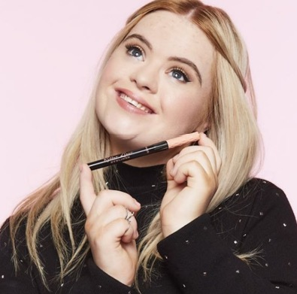
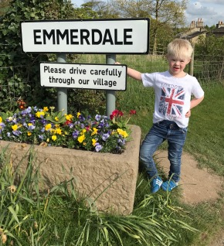
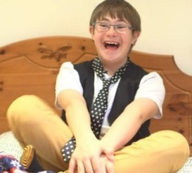
Some people with Down syndrome enjoy acting and modelling too.

Slide 35
People with Down syndrome can get married.

Slide 36
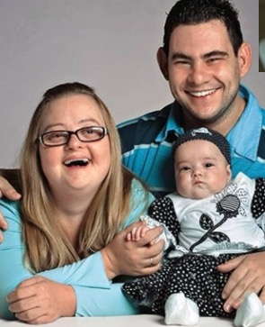
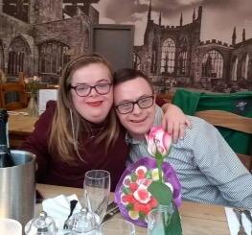
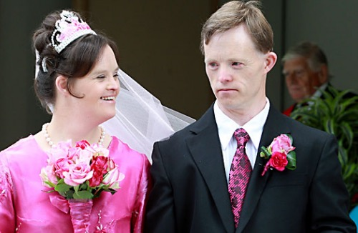
People with Down syndrome can get married.
Yes, they can!
People with Down syndrome enjoy relationships.

Slide 37
People with Down syndrome can’t play sports.

Slide 38
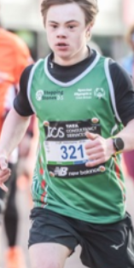
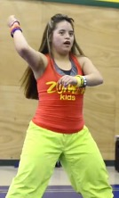
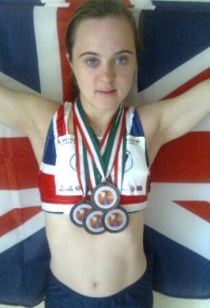
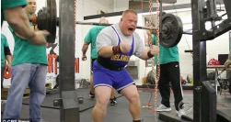
People with Down syndrome can’t play sports.
False!
People with Down syndrome enjoy a variety of sports, including things like running marathons and CrossFit.

Slide 39
People with Down syndrome can’t drive.

Slide 40
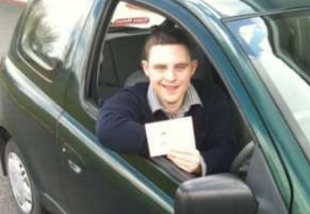
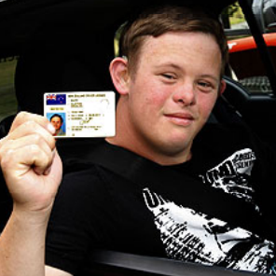
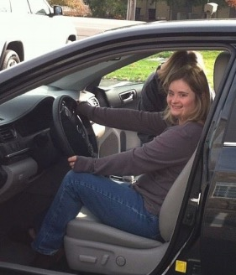
People with Down syndrome can’t drive.
Yes, they can!
Young people with Down syndrome enjoy getting about.

Slide 41
Children with Down syndrome like the same things as other children.

Slide 42

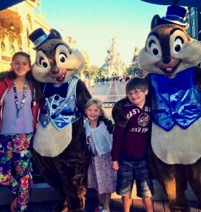
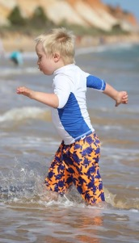
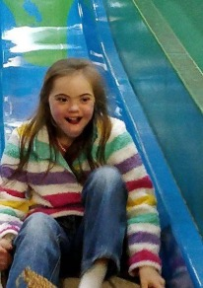
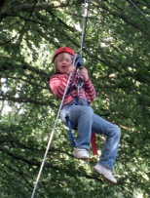

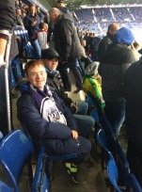
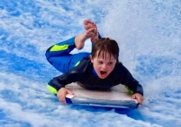
Children with Down syndrome like the same things as other children.
Absolutely!
Children with Down syndrome enjoy the same things as all children do.

Slide 43
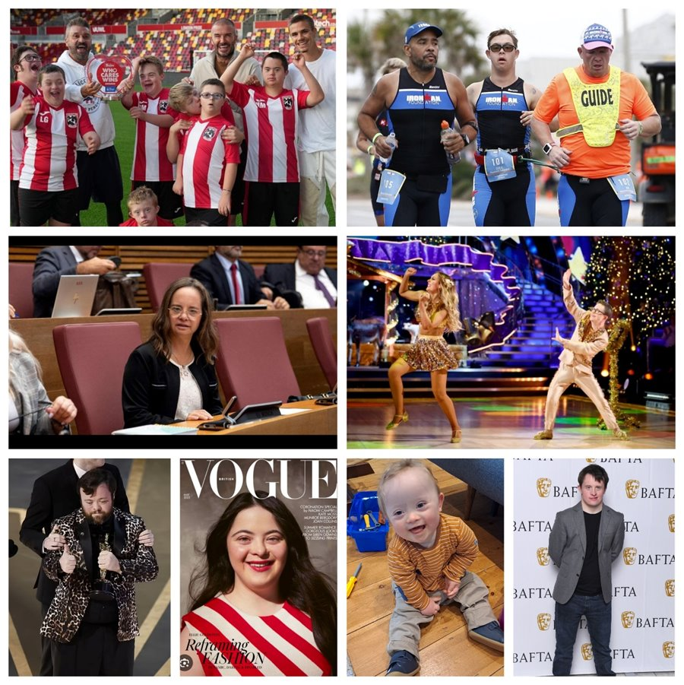
What do you now know about Down
syndrome?

Slide 44
PSHE - Friendship

Slide 45

PROUD
What things about yourself are you proud TO BE?

Slide 46

What things about yourself are you PROUD of?
Tell me one thing you are proud that you have done (achieved).
Tell me one special thing about you as a person.

Slide 47
Let's look at what ideas we came up with.
Why are you proud of these things?

Slide 48
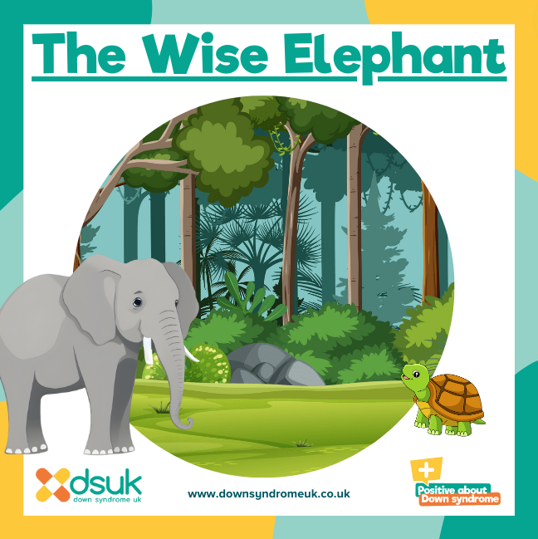
Let's read a story together.

Slide 49
Let's talk about this story.

Slide 50
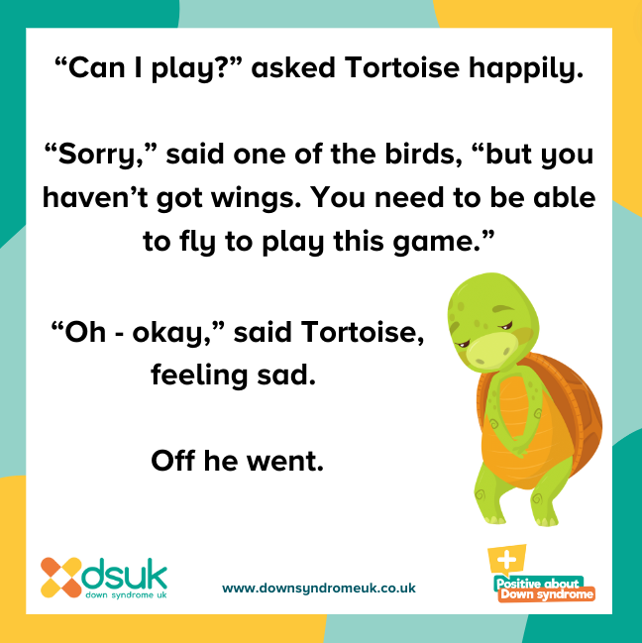
How did Tortoise feel when the other animals wouldn't let him play? Why?

Slide 51
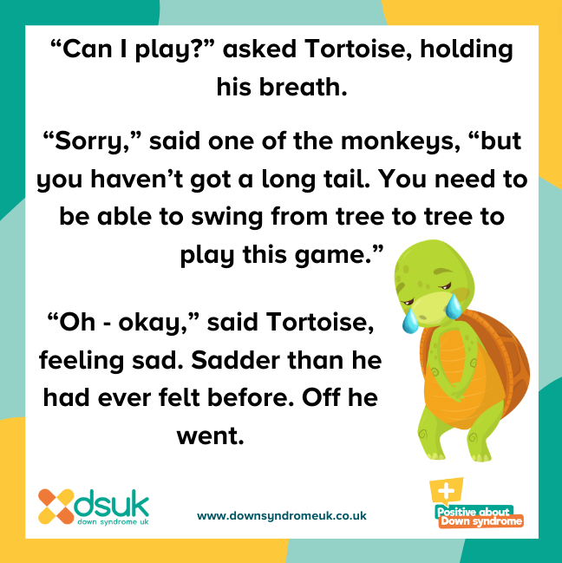
What do you think about the reasons the other animals gave?

Slide 52
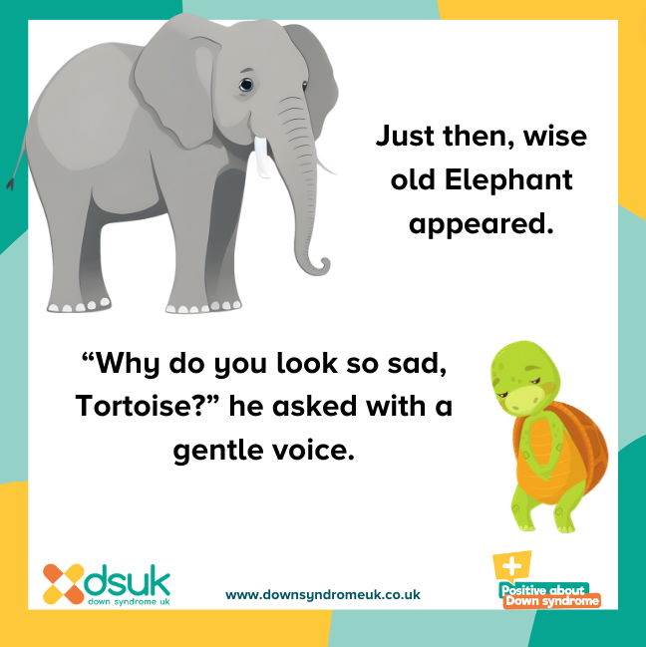
How is elephant a kind friend?

Slide 53
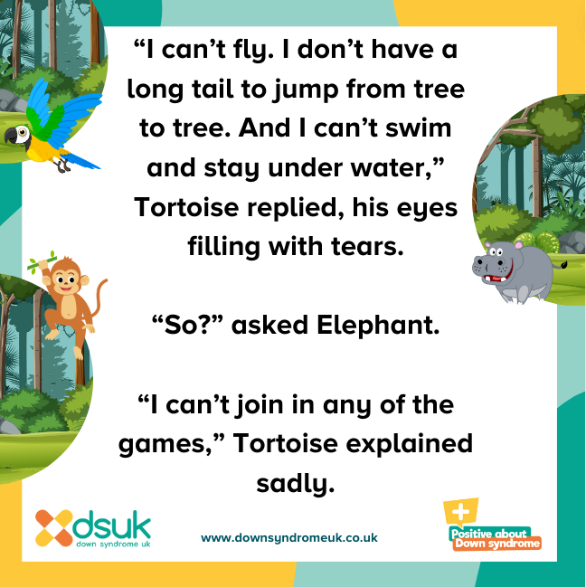
How have the other animals made Tortoise feel?

Slide 54
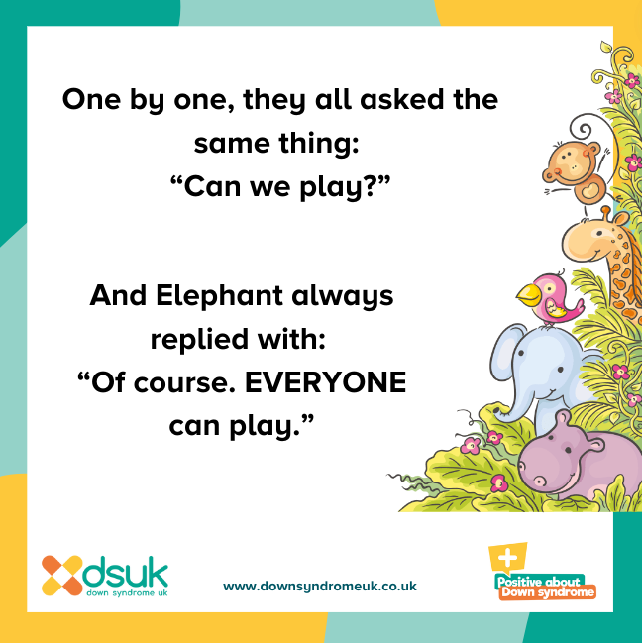
What are the good things about Elephant's game?

Slide 55

What have you learnt from this story?

Slide 56
FRIENDSHIP
What things make a good friend?

Slide 57
What makes a good friend?

Slide 58

What might they say/not say?
Let's collect some ideas.

Slide 59
What might they do/not do?
Let's collect some ideas.

Slide 60
How might they make you feel?
Let's collect some ideas.

Slide 61
What might they make us think about
ourselves?
Let's collect some ideas.

Slide 62
How do you know if you are being a good friend?

Slide 63
Who deserves to have good friends?

Slide 64
RIGHTS
What things do all people deserve TO BE?

Slide 65

What do all people DESERVE?
When reading our story and talking about friendship, we have been thinking about how all people deserve to be treated.
How should we treat EVERYONE?

Slide 66
Let's look at what ideas we came up with.
Why do we all deserve these things?
How can we make sure all people are treated in this way?

Slide 67
Fill in the gaps to complete the sentence. Tell your answer to your partner.
I am proud that I am _________ because this makes my friends feel ________.

Slide 68
PSHE - Aspirations

Slide 69
ASPIRATIONS
What do you want TO BE when you are older?

Slide 70

What do you want to be when you are older?
What job would you like to do? Why?

Slide 71
Draw the job that you want to be on your piece of paper and we will put them on our sheet altogether.

Slide 72
What jobs do we need people to do?

Slide 73








Slide 74







Slide 75










Slide 76
Why is it a good thing that people want to do all different types of jobs?

Slide 77
Can people be anything that they want to be?

Slide 78
Who can be a firefighter?

Slide 79




Who can be
a firefighter?

Slide 80
What must you be like to be a
firefighter?

Slide 81
What must you be like to be a
firefighter?
brave
calm
a team
player
determined

Slide 82
Who can be a nurse?

Slide 83




Who can be
a nurse?

Slide 84
What must you be like to be a
nurse?

Slide 85
What must you be like to be a
nurse?
kind
caring
patient
calm

Slide 86
Fill in the gaps to complete the sentences. Tell your answer to your partner.
_____ jobs are important.
Jobs can be done by ________.

Slide 87
How would you feel if someone told you that you couldn't do the job you wanted?

Slide 88
How would you feel if someone assumed that you couldn't do something?

Slide 89
How might you feel?
If your teacher assumed that you didn't enjoy break times...
What might happen?

Slide 90
How might you feel?
If your friend assumed you didn't want to play with them anymore...
What might happen?

Slide 91
How might you feel?
If your teacher assumed you couldn't learn new things...
What might happen?

Slide 92
Unfortunately, due to some stereotypes about Down syndrome, some people might assume that a person with Down syndrome can't do certain things.

Slide 93
Why should we never assume what a person can or can't do based on just one thing about them?

Slide 94
If we make assumptions about what a person can or can't do, we might not ever give them the opportunity to try to do something and then they might never be able to do it.

Slide 95
Fill in the gaps to complete the sentences. Tell your answer to your partner.
We should always believe that someone ______ do something and give them the ______ to try.

Slide 96
English

Slide 97
What makes a good friend?

Slide 98

We are going to work together to create a list poem about friendship.
We are going to think about what friendship is and how friendship makes us feel.

Slide 99


Slide 100


Slide 101
Art

Slide 102
Task One

Slide 103
Why is difference good?
How is difference beautiful?
What would art be like without difference?
What would life be like without difference?

Slide 104


Slide 105


Slide 106


Slide 107
Task Two

Slide 108
What makes a good friend?

Slide 109



Slide 110



