Slide 1


Slide 2
October is Down Syndrome Awareness Month.​
​
Today, we are going to be learning all about Down syndrome and thinking about how the way that we think, speak and act can have an impact on all of the people that we share our world with.​

Slide 3
Let's take a look at some of the vocabulary that we will be using today...

Slide 4
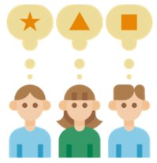

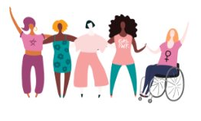


Diversity
Stereotype
Aspiration
Key Vocabulary​
​
Awareness
​
Difference​
​
Equality
​
Inclusion

Slide 5
Key Vocabulary​
​
Awareness: Having knowledge and understanding.​
​
Difference: When things are not exactly the same.​
​
Equality: Fairness. Justness. Being equal in rights, status and opportunities.​
​
Inclusion: Providing equal access to opportunities and resources.

Slide 6
Key Vocabulary​
​
Diversity: The practice of including all people, regardless of things like race, gender or disabilities.
Stereotype: A fixed general image that a lot of people believe about something, which can be over-simplified, unjust and problematic.
Aspiration: A strong desire to achieve something.

Slide 7
We are also going to be thinking about some of our British Values today:​
​
Mutual Respect​
Tolerance
Can you remember what these values mean?

Slide 8



Tolerance:
Accepting differences and celebrating differences.
Mutual Respect:
Treating everyone kindly and fairly, no matter who they are.

Slide 9
Why do you think these values are so important?
Do they link to any of our school values?

Slide 10

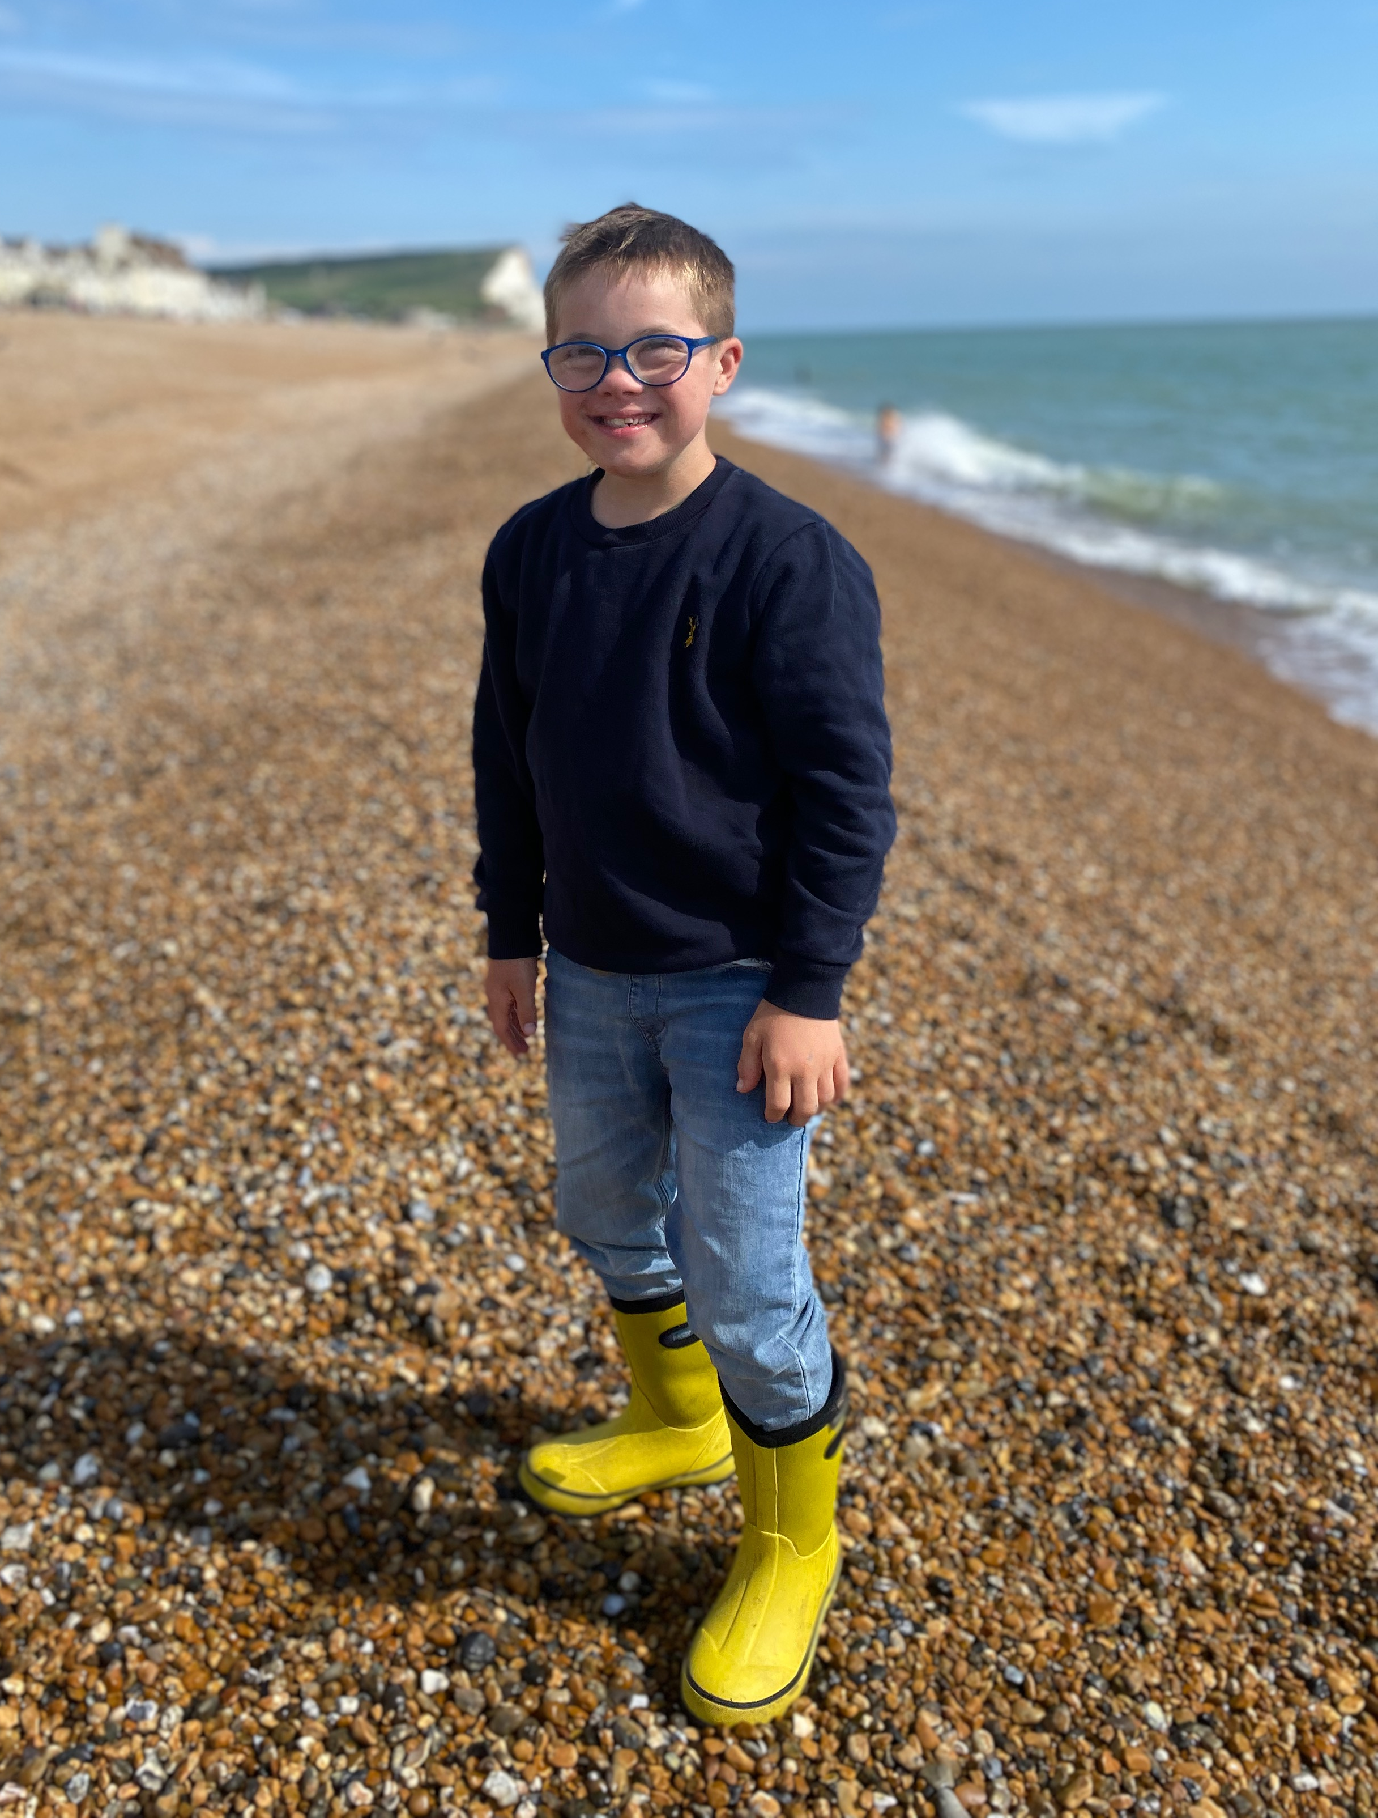


What do you already think you know about Down syndrome?

Slide 11
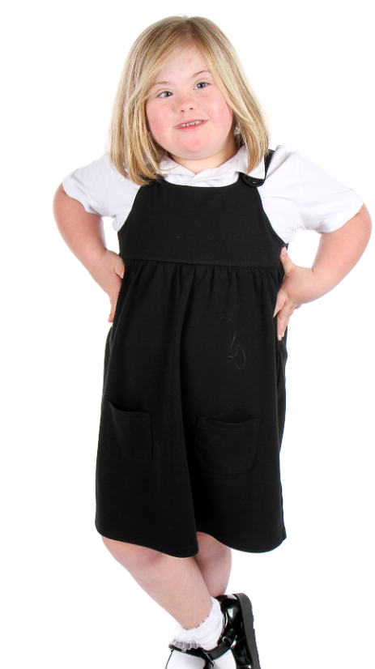

Just like you!
Let's watch the first part of this video (up until 2:39) to find out a little bit more about Down syndrome.
Just Like You-Down Syndrome
What are your thoughts and feelings so far?
Do you have any questions?

Slide 12
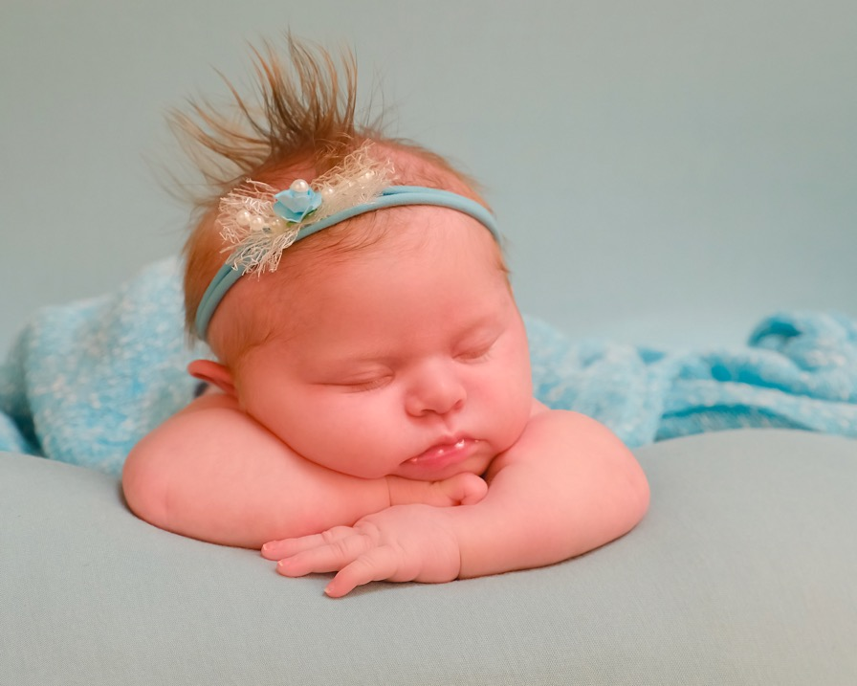
What is Down syndrome?
Some babies are born with Down syndrome and will always have it.
Down syndrome is not an illness. You cannot catch it like a cold.

Slide 13
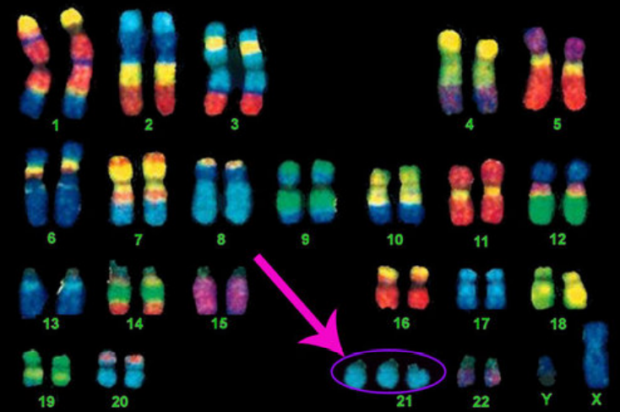
There are things in our body called chromosomes and they decide on things like what colour eyes you have.
Down syndrome is caused by an extra chromosome.
Having Down syndrome is just one part of a person – just like eye colour.

Slide 14
Because these look like colourful socks, this is why people often wear bright, colourful socks to raise awareness about Down syndrome.

Slide 15
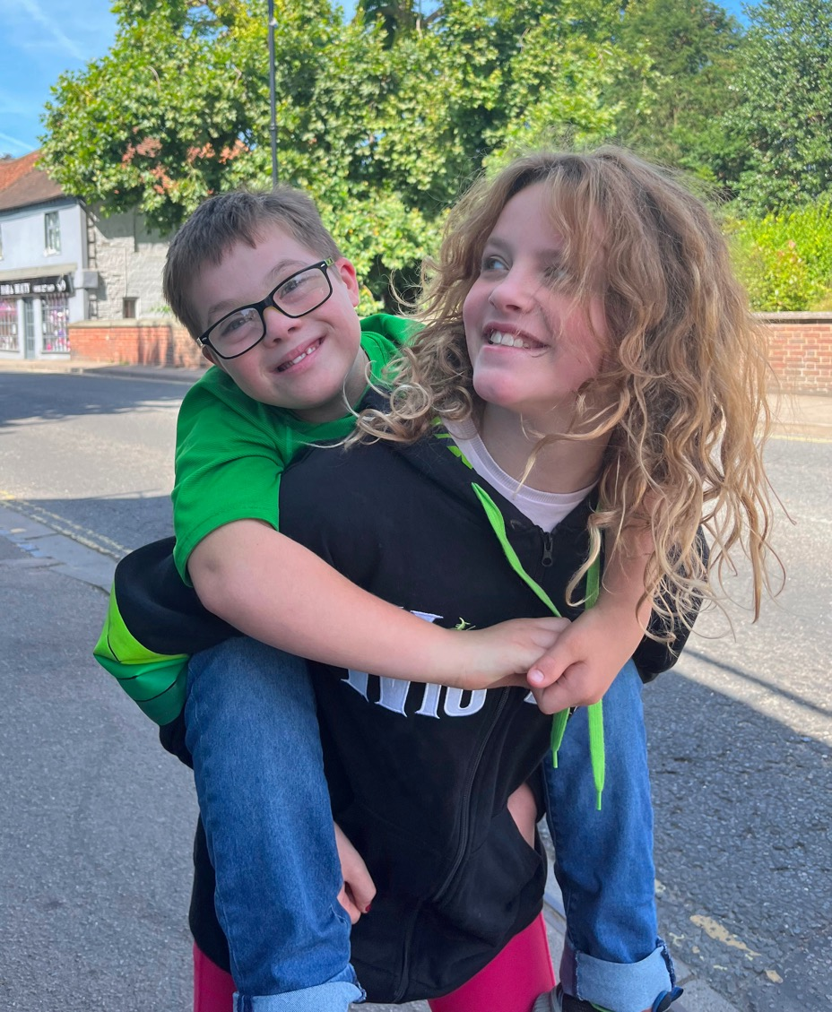
Children with Down syndrome share some physical characteristics but look more like their families than each other.

Slide 16
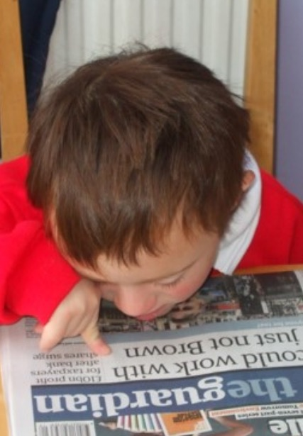
It may take children with Down syndrome longer to learn some things.
They might need some extra practice or support.

Slide 17
Can you always do something straight away? Can you think of a time you needed extra help or time?

Slide 18
How does it feel when it is tricky to do something? How can other people help at times like this?

Slide 19
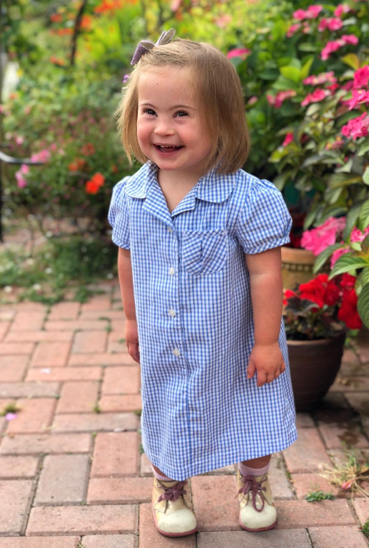
Children with Down syndrome:
Are good at some things and have to work really hard at others – just like all children.
Want to be included and treated with kindness – just like all children.
Have wants, hopes, dreams and feelings - just like all children.
Have likes and dislikes – just like all children.
Are all individuals – just like all children.

Slide 20
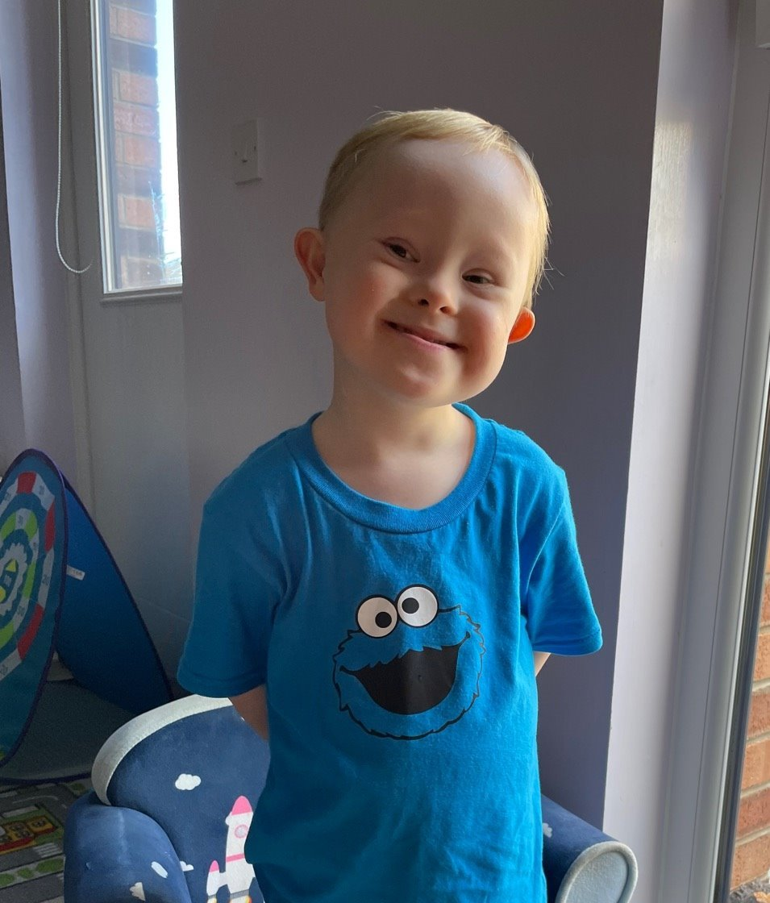
https://www.youtube.com/watch?v=_r_2rmDYfz4
Let's watch a video to find out a little bit more about Down syndrome.

Slide 21
Do you think these statements about Down syndrome are true or false?
Children with Down syndrome can’t go to school.
Children with Down syndrome are always happy.
People with Down syndrome can get a job.
People with Down syndrome can get married.
People with Down syndrome can’t drive.
People with Down syndrome can’t play sports.
Children with Down syndrome like the same things as other children.

Slide 22
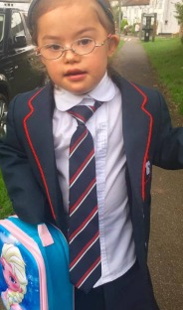
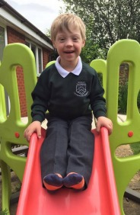
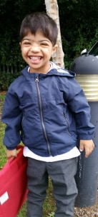
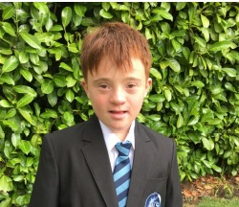
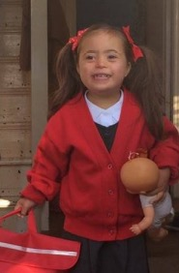
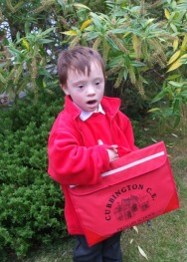
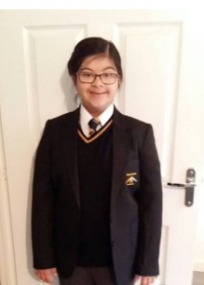
Children with Down syndrome can’t go to school.
False
Children with Down syndrome enjoy going to school.

Slide 23
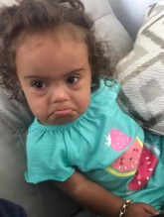
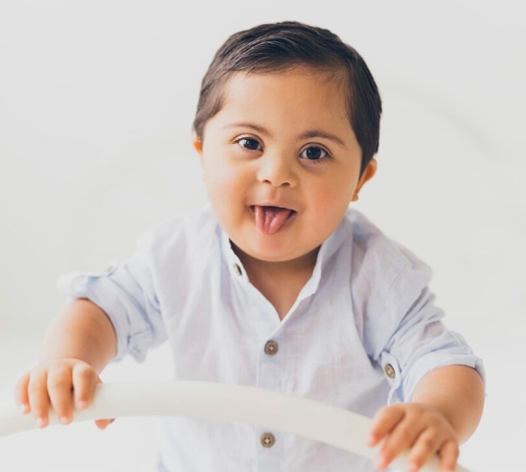
Children with Down syndrome are always happy.
False
Children with Down syndrome experience all emotions - just like you do!

Slide 24
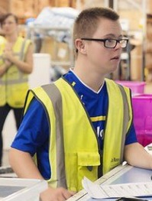
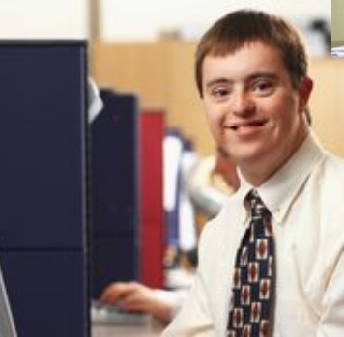
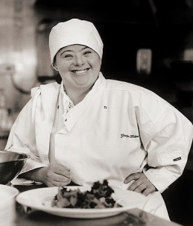

People with Down syndrome can get a job.
Absolutely!
People with Down syndrome enjoy working in a variety of roles.

Slide 25
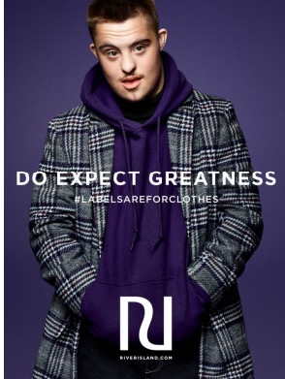
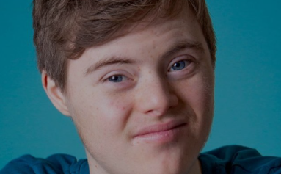
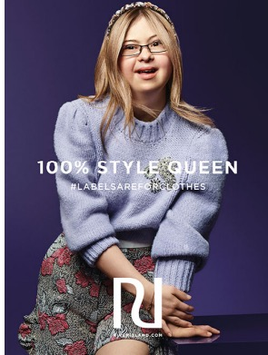
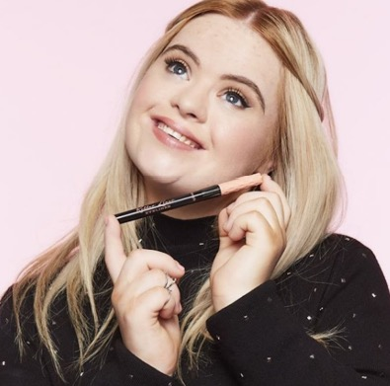
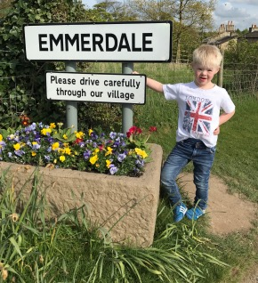
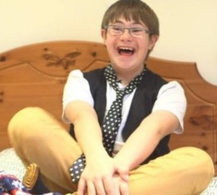
Some people with Down syndrome enjoy acting and modelling too.

Slide 26
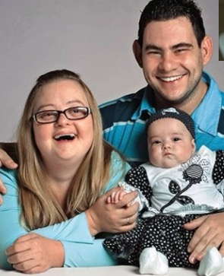
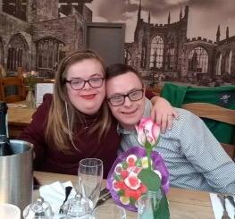
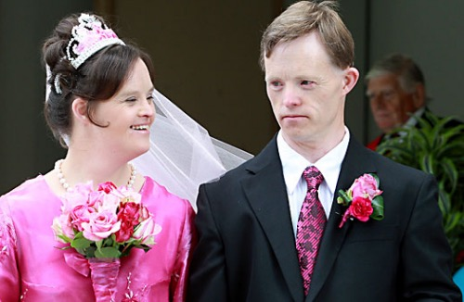
People with Down syndrome can get married.
Yes, they can!
People with Down syndrome enjoy relationships.

Slide 27
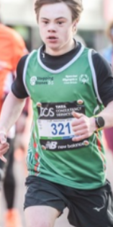
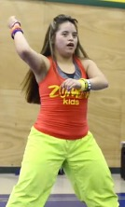
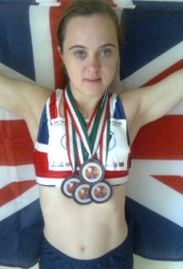
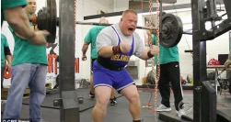
People with Down syndrome can’t play sports.
False!
People with Down syndrome enjoy a variety of sports, including things like running marathons and CrossFit.

Slide 28
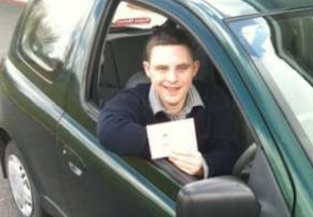
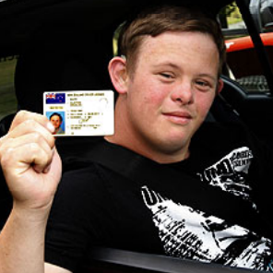
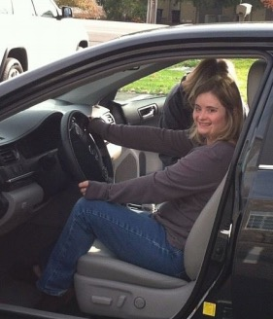
People with Down syndrome can’t drive.
Yes, they can!
Young people with Down syndrome enjoy getting about.

Slide 29

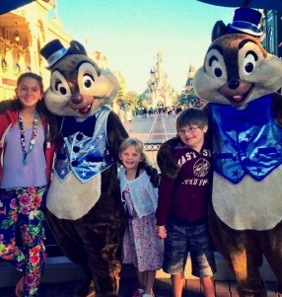
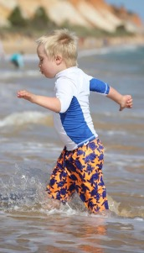
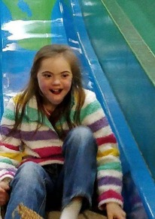
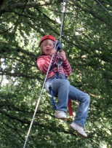

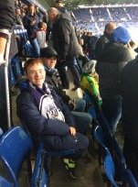
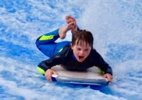
Children with Down syndrome like the same things as other children.
Absolutely!
Children with Down syndrome enjoy the same things as all children do.

Slide 30
What do you now know about Down syndrome?
Why do you think we have an awareness month for Down syndrome?
How will learning about Down syndrome change how you think or act?
Do you have any questions?

Slide 31
We are now going to take what we have learnt about Down syndrome and apply it to our wider PSHE learning.

Slide 32

ASPIRATIONS
What do you want TO BE when you are older?

Slide 33

What ASPIRATIONS do you have for yourself?
Complete the task by filling the page with all of your ideas. You could think of a job you would like (e.g. teacher), or an emotion (e.g. happy) or a character trait (e.g. kind).

Slide 34
Let's look at what you have written.
Why do you want to be all of the things that you have written down?

Slide 35
Will everyone's page look exactly the same? Why/why not?
Why is this a positive thing?

Slide 36
How would you feel if someone told you that you couldn't do the job you wanted?

Slide 37
How would you feel if someone assumed that you couldn't do something?

Slide 38
How might you feel?
If your teacher assumed that you didn't enjoy break times...
What might happen?

Slide 39
How might you feel?
If your friend assumed you didn't want to play with them anymore...
What might happen?

Slide 40
How might you feel?
If your teacher assumed you couldn't learn new things...
What might happen?

Slide 41
Unfortunately, due to some stereotypes about Down syndrome, some people might assume that a person with Down syndrome can't do certain things.

Slide 42
What is a stereotype?
Why are stereotypes bad?

Slide 43
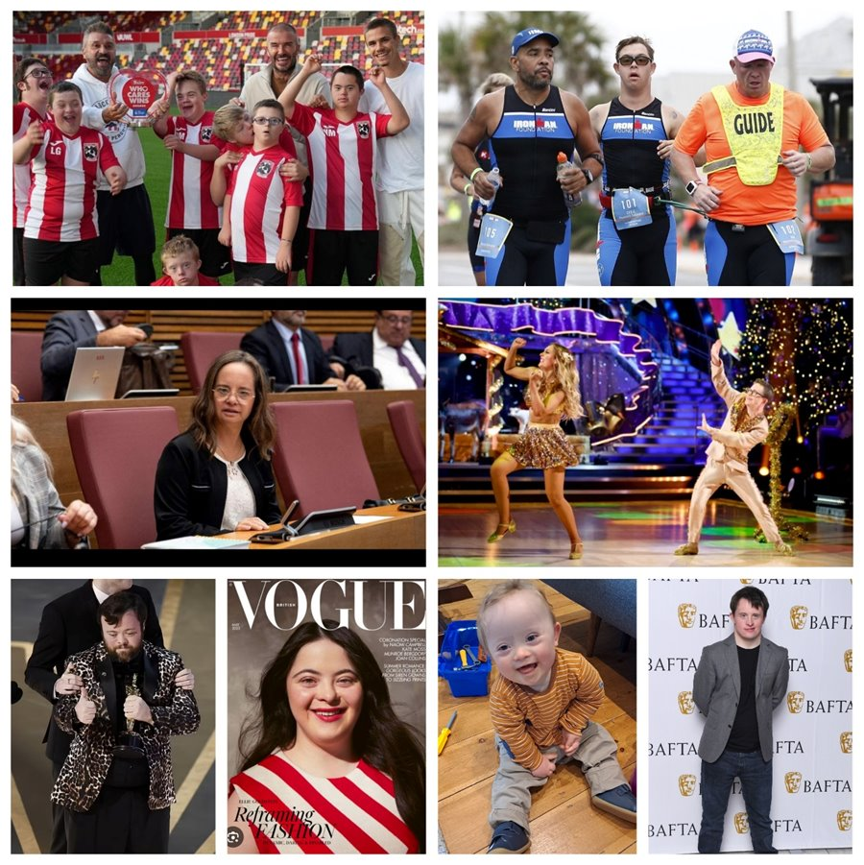
Why should we never assume what a person can or can't do based on just one thing about them?

Slide 44
If we make assumptions about what a person can or can't do, we might not ever give them the opportunity to try to do something and then they might never be able to do it.

Slide 45
In 1967, Kathrine Switzer became the first woman to officially run the Boston Marathon even though they tried to physically stop her from running.
It was assumed that women wouldn't be able to run a marathon and that they should not even try!

Slide 46
Why do you think she wanted to do it?

Slide 47
What might have happened if she hadn't done this?

Slide 48
PROUD
What things about yourself are you proud TO BE?

Slide 49

What things about yourself are you PROUD of?
Complete the task by filling the page with all of your ideas. You could think of aspects of who you are (e.g. race or religion) or your character traits (e.g. loyal, respectful).

Slide 50
Let's look at what you have written.
Why are you proud of these things?

Slide 51
Will everyone's page look exactly the same? Why/why not?
Why is this a positive thing?

Slide 52
How would it feel if someone treated you in a negative way due to an aspect of yourself that you should be proud of?
How can we make sure that people celebrate differences so that people can be proud of who they are?
How can we make sure that difference is represented in our world?

Slide 53
RIGHTS
What things do all people have the right TO BE?

Slide 54

What things do all people have the RIGHT to be? What do all people DESERVE?
Complete the task by filling the page with all of your ideas. You can think of human rights, treatment and opportunities.

Slide 55
All people are born free and equal.
Everyone has a right to life, liberty, and security of their person.
Everyone should be protected from any kind of discrimination.
Everyone has a right to an education and the right to get a job.
Everyone has a right to vote and take part in the government of one's own country.
Everyone has a right to have a nationality.
Everyone has a right to take part in cultural life—to choose a way of life.
No person may be treated in a cruel or unkind way.
Everyone has a right to have ideas or opinions, to decide what is right and what is wrong, and to choose a religion.
What are human rights?
Human rights are a set of rules that support how all people can be treated equally and with respect.
Everyone, everywhere in the world, is entitled to human rights.

Slide 56
Let's look at what you have written.
Why do we all deserve these things?
How can we make sure all people are treated in this way?

Slide 57
What have we learnt today?
Why should we challenge and end stereotypes?
Stereotypes are bad because...
We shouldn't make ____________ about someone based on just one thing about them.

Slide 58
What have we learnt today?
Why should difference and diversity be celebrated?
Difference is good because...
If we didn't have difference, life would be...

Slide 59
What have we learnt today?
People should be treated fairly because...
Everyone should be included because...
Everyone should have the same opportunities because...
Why are equality and inclusion so important?

Slide 60
Let's take what we have learnt and apply it in different ways.

Slide 61
English

Slide 62
Task One

Slide 63
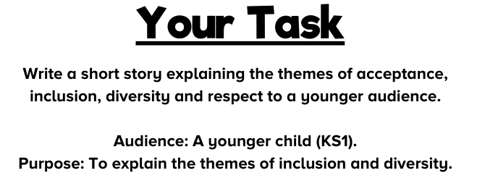
How will the audience shape our writing?
How will the purpose shape our writing?

Slide 64
How will the audience shape our writing?
Simple language choices
Simple plot line
Fun/cute characters
Repetition
Include simple speech/dialogue (which could be read aloud in different voices)
Make the point of the story clear
Not too long
Could include pictures to go along with the words

Slide 65
How will the purpose shape our writing?
Plot needs to be easy to follow
Message of the story needs to be clear
Use the feelings of the characters to help the audience to empathise
Break the story into chunks so that an adult could stop and ask questions to the children at regular points e.g. "How do you think the character is feeling? Why?"

Slide 66
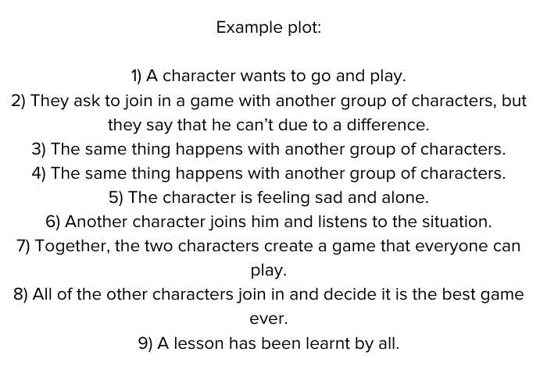
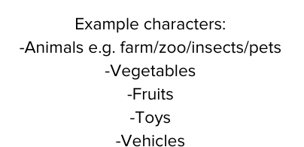
How could we use these ideas to help us to teach younger children about diversity and inclusion?

Slide 67
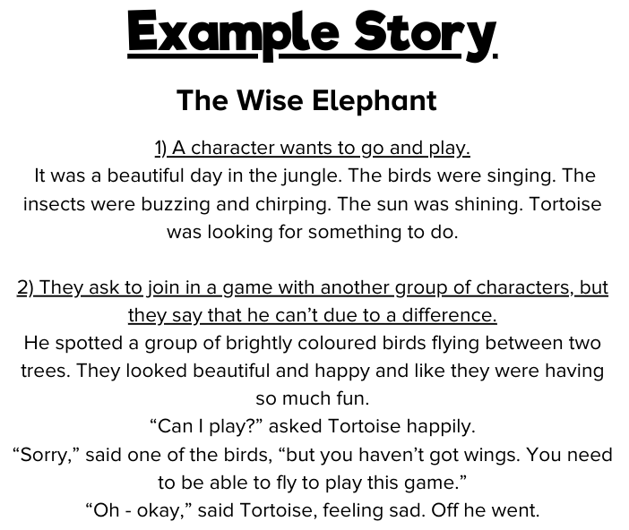

Slide 68
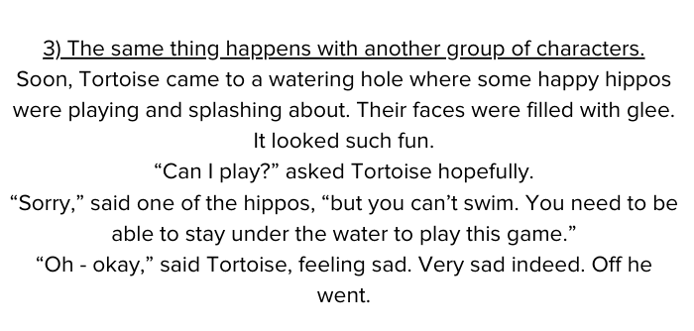

Slide 69


Slide 70


Slide 71


Slide 72


Slide 73


Slide 74


Slide 75
Let's rehearse our stories orally before we begin writing. Tell your story to another person in the class. Remember to use your reading fluency skills to make the story exciting and engaging!

Slide 76
It is time to edit and revise your stories.
Edit:
Are there any spelling errors?
Can you find any errors with punctuation? Look for any examples of missing punctuation or examples of punctuation used incorrectly.
Are there any grammatical errors? Check that your writing makes sense. Check for errors or inconsistencies with tense and person.
Revise:
Check: Does your story meet the intended purpose? Do you need to add/change/remove anything?
Check: Is your story suitable for the intended audience? Do you need to add/change/remove anything?
Are you happy with the content? Can you make any improvements?
Are you happy with your vocabulary choices? Can you make any improvements?

Slide 77
Task Two

Slide 78

What do these words mean?
Why are these themes so important?
Can you give any examples?

Slide 79


Slide 80

What is the purpose of each letter?

Slide 81

Who is the audience for each letter?

Slide 82

What would be the best formality and tone for each letter?

Slide 83

Which letters would be persuasive?

Slide 84
It is time to plan and then write your letters.
You may wish to make some notes as a plan before you begin writing. Consider the following:
Purpose: What do you want your letter to do? Persuade? Inform? Explain? Entertain?
Audience: Who are you writing to? How will this affect your writing?
Tone/Formality: What kind of tone are you using? Are you writing a formal or informal letter?
Introduction: Set out who you are (greeting) and your purpose for writing (intent).
Main paragraphs: Decide on your key ideas and a theme for each paragraph.
Conclusion: Conclude your writing by summarising your main ideas/points.

Slide 85
It is time to edit and revise your letters.
Edit:
Are there any spelling errors?
Can you find any errors with punctuation? Look for any examples of missing punctuation or examples of punctuation used incorrectly.
Are there any grammatical errors? Check that your writing makes sense. Check for errors or inconsistencies with tense and person.
Revise:
Check: Does your letter meet the intended purpose? Do you need to add/change/remove anything?
Check: Is your letter suitable for the intended audience? Do you need to add/change/remove anything?
Check: Are you happy with your tone and formality? Do you need to add/change/remove anything?
Are you happy with the content? Can you make any improvements?
Are you happy with your vocabulary choices? Can you make any improvements?

Slide 86
Art

Slide 87
Task One

Slide 88
Why is difference good?
How is difference beautiful?
What would art be like without difference?
What would life be like without difference?

Slide 89


Slide 90


Slide 91



Slide 92


You could come up with your own wording inspired by all of the themes that we have explored in our learning.

Slide 93


You could find and use an inspirational
quote linked to the themes we have been exploring.

Slide 94
Task Two

Slide 95

What words can you think of linked to the themes that we have been exploring?

Slide 96



Slide 97
Music

Slide 98

Can you think of any songs that you know that are linked to any of these themes?

Slide 99

Why are songs good for making people think or feel a certain way?

Slide 100


If you would like to, you can use some of these words or ideas to get you started.

Slide 101

Why is this important?

Slide 102
Research
Task

Slide 103


Can you think of any people whose lives are/were linked to these themes?

