Slide 1


Slide 2
October is Down Syndrome Awareness Month.​
​
Today, we are going to be learning all about Down syndrome and thinking about how the way that we think, speak and act can have an impact on all of the people that we share our world with.​

Slide 3
Let's take a look at some of the vocabulary that we will be using today...

Slide 4
Diversity
Stereotype
Aspiration
Key Vocabulary​
​
Awareness
​
Difference​
​
Equality
​
Inclusion

Slide 5
Key Vocabulary​
​
Awareness: Having knowledge and understanding.​
​
Difference: When things are not exactly the same.​
​
Equality: Fairness. Justness. Being equal in rights, status and opportunities.​
​
Inclusion: Providing equal access to opportunities and resources.

Slide 6
Key Vocabulary​
​
Diversity: The practice of including all people, regardless of things like race, gender or disabilities.
Stereotype: A fixed general image that a lot of people believe about something, which can be over-simplified, unjust and problematic.
Aspiration: A strong desire to achieve something.

Slide 7
We are also going to be thinking about some of our British Values today:​
​
Mutual Respect​
Tolerance
Can you remember what these values mean?

Slide 8
Tolerance:
Understanding, appreciating and celebrating
diversity.
Listening to and respecting other viewpoints.
Mutual Respect:
Treating others how you would wish to be treated.
Respecting others.
Why do you think these values are so important?
Do they link to any of our school values?

Slide 9

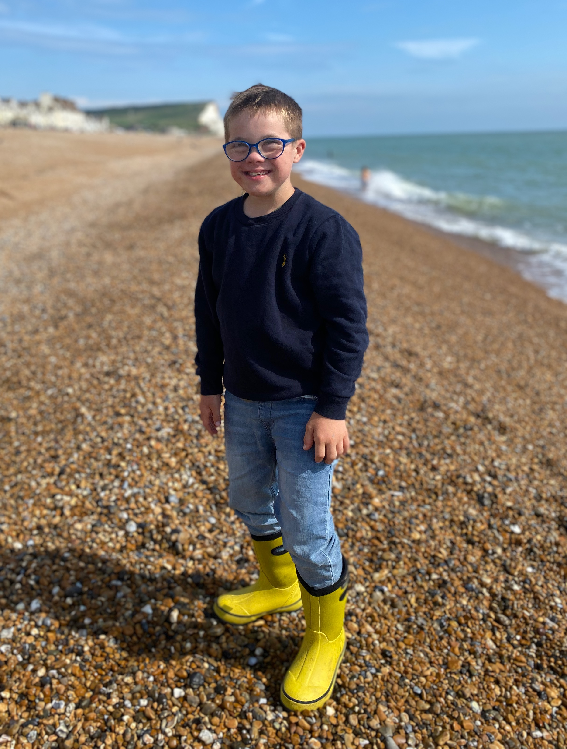


What do you already think you know about Down syndrome?

Slide 10
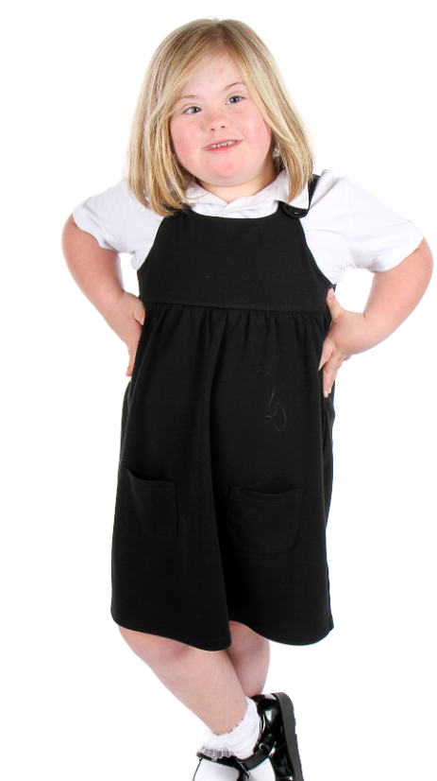

Just like you!
Let's watch the first part of this video (up until 2:39) to find out a little bit more about Down syndrome.
Just Like You-Down Syndrome
What are your thoughts and feelings so far?
Do you have any questions?

Slide 11
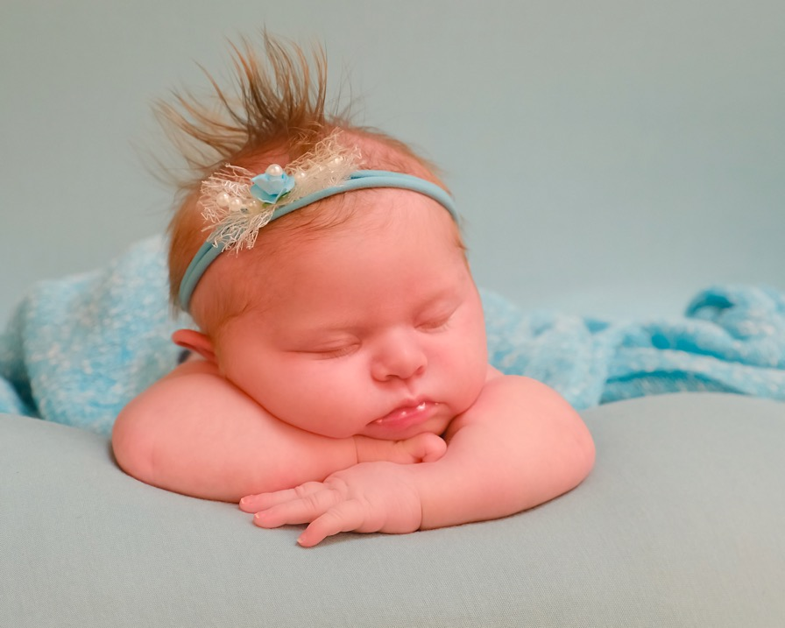
What is Down syndrome?
Some babies are born with Down syndrome and will always have it. Down syndrome is not an illness. You cannot catch it like a cold.

Slide 12
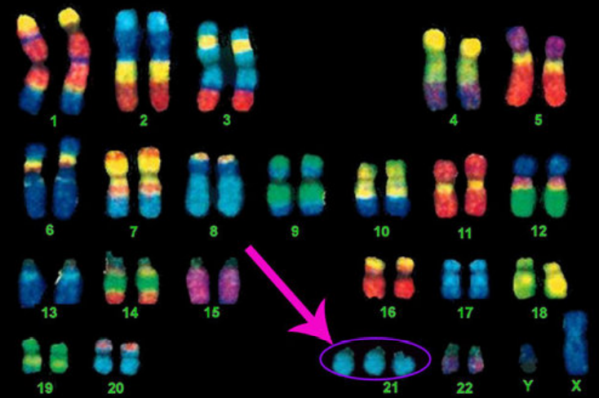
What is Down syndrome?​
Down syndrome is caused by an extra chromosome in your cells
Chromosomes come in pairs - we get half from our mum and half from our dad
People without Down Syndrome have 46 chromosomes (23 pairs)
People with Down Syndrome have 47 chromosomes with a 3rd copy of 21st Chromosome

Slide 13
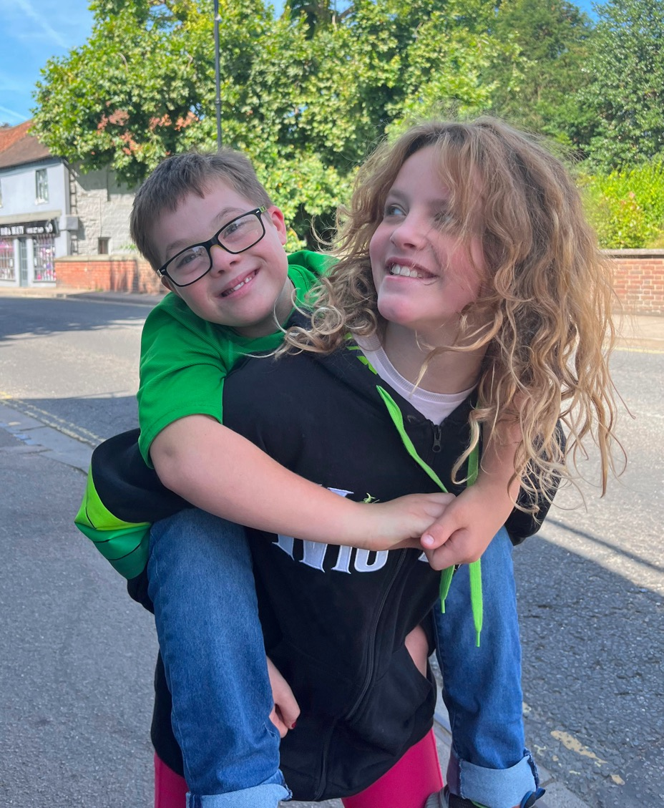
Children with Down syndrome share some physical characteristics but look more like their families than each other.

Slide 14
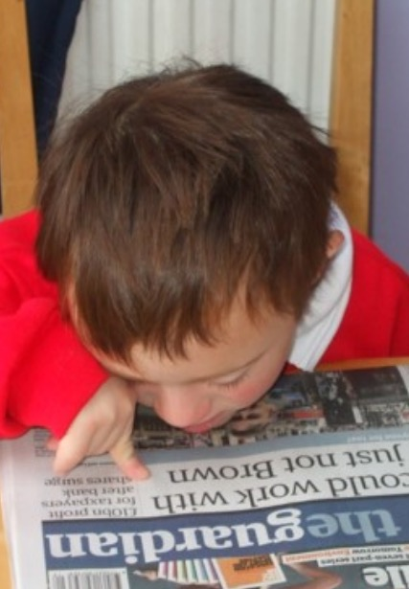
Having Down syndrome can affect someone's speech, learning and physical development.
This doesn't mean that a child with Down syndrome can't do something - it just might mean they learn in a different way or need some extra time, practice or support.

Slide 15
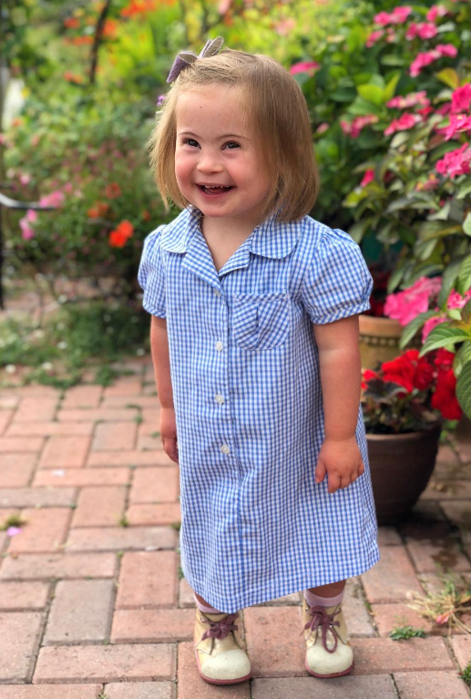
Children with Down syndrome:
Are good at some things and have to work really hard at others – just like all children.
Want to be included and treated with kindness – just like all children.
Have wants, hopes, dreams and feelings - just like all children.
Have likes and dislikes – just like all children.
Are all individuals – just like all children.

Slide 16
Do you think these statements about Down syndrome are true or false?
Children with Down syndrome can’t go to school.
Children with Down syndrome are always happy.
People with Down syndrome can get a job.
People with Down syndrome can get married.
People with Down syndrome can’t drive.
People with Down syndrome can’t play sports.
Children with Down syndrome like the same things as other children.

Slide 17
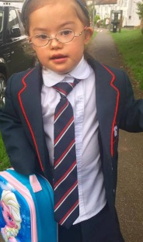
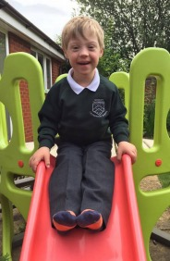
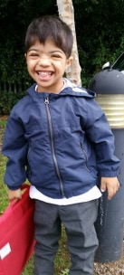
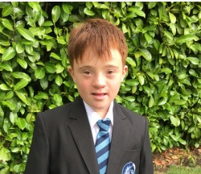
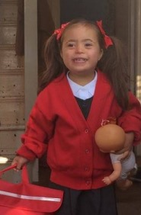
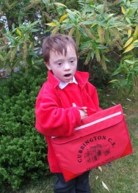
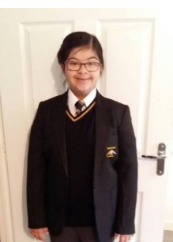
Children with Down syndrome can’t go to school.
False
Children with Down syndrome enjoy going to school.

Slide 18
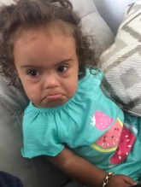
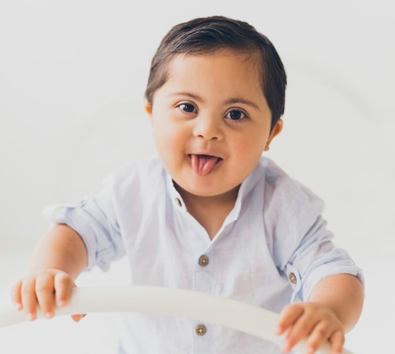
Children with Down syndrome are always happy.
False
Children with Down syndrome experience all emotions - just like you do!

Slide 19
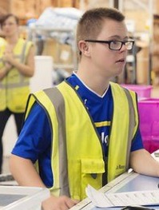
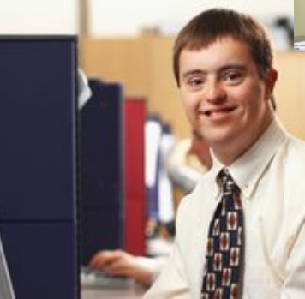
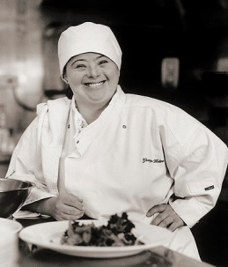

People with Down syndrome can get a job.
Absolutely!
People with Down syndrome enjoy working in a variety of roles.

Slide 20
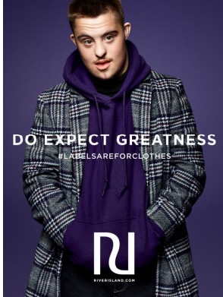
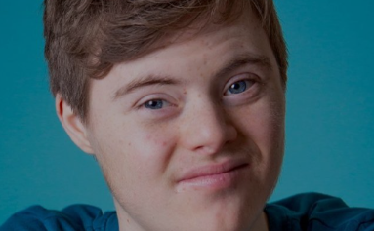
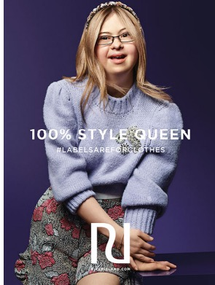
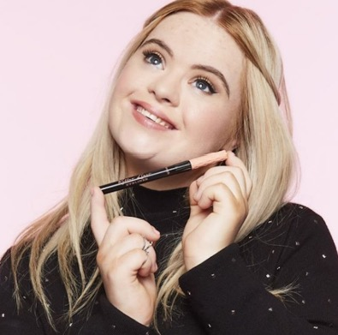
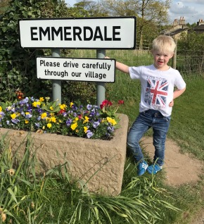
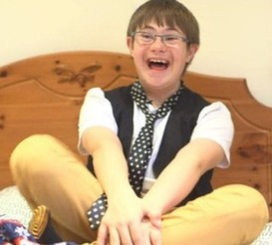
Some people with Down syndrome enjoy acting and modelling too.

Slide 21
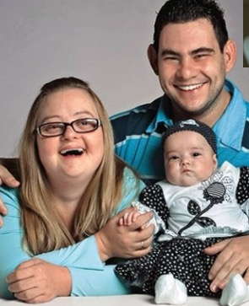
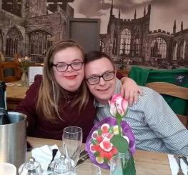
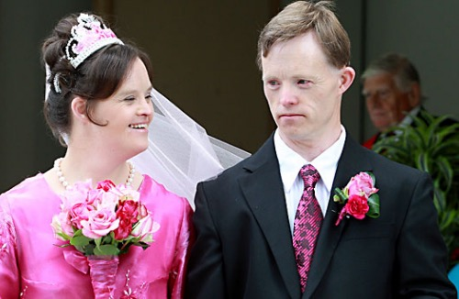
People with Down syndrome can get married.
Yes, they can!
People with Down syndrome enjoy relationships.

Slide 22
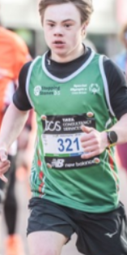
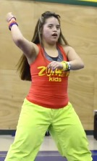
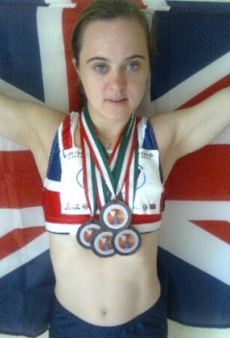
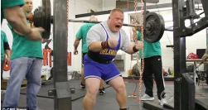
People with Down syndrome can’t play sports.
False!
People with Down syndrome enjoy a variety of sports, including things like running marathons and CrossFit.

Slide 23
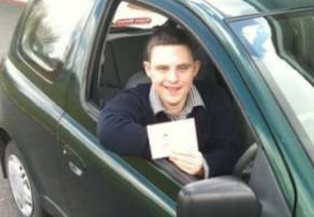
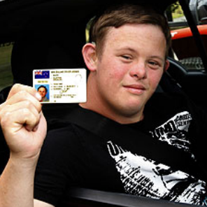
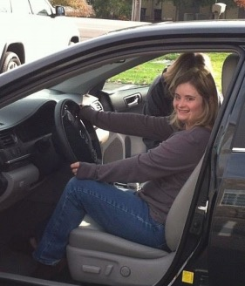
People with Down syndrome can’t drive.
Yes, they can!
Young people with Down syndrome enjoy getting about.

Slide 24

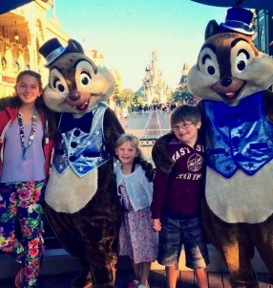
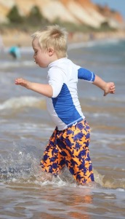
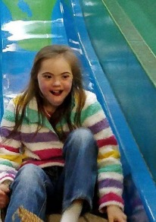
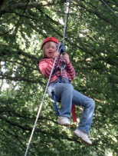

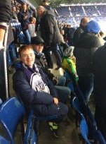
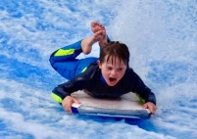
Children with Down syndrome like the same things as other children.
Absolutely!
Children with Down syndrome enjoy the same things as all children do.

Slide 25
What do you now know about Down syndrome?
Why do you think we have an awareness month for Down syndrome?
How will learning about Down syndrome change how you think or act?
Do you have any questions?

Slide 26
We are now going to take what we have learnt about Down syndrome and apply it to our wider PSHE learning.

Slide 27

ASPIRATIONS
What do you want TO BE when you are older?

Slide 28

What ASPIRATIONS do you have for yourself?
Complete the task by filling the page with all of your ideas. You could think of a job you would like (e.g. teacher), or an emotion (e.g. happy) or a character trait (e.g. kind).

Slide 29
Let's look at what you have written.
Why do you want to be all of the things that you have written down?

Slide 30
Will everyone's page look exactly the same? Why/why not?
Why is this a positive thing?

Slide 31
How would you feel if someone told you that you couldn't do those things because of something about you?
Or assumed you couldn't do something due to just one aspect of who you are?

Slide 32
In 1967, Kathrine Switzer became the first woman to officially run the Boston Marathon even though they tried to physically stop her from running.
It was assumed that women wouldn't be able to run a marathon and that they should not even try!

Slide 33
Why do you think she wanted to do this?
What might have happened if she hadn't done this?

Slide 34
Can you think of any examples that you know of or examples from our past learning where assumptions have been made about a person due to just one aspect of who they were e.g. disability, race or religion?

Slide 35
Unfortunately, due to some stereotypes about Down syndrome, some people might assume that a person with Down syndrome can't do certain things.
What do you think about this?
What do you think could happen if you assume that someone can't do something?
How does this make you feel?

Slide 36
What do you think would happen if a teacher made this assumption about a class?
This class can't read.
What might the teacher do/not do?
How might the class feel?

Slide 37
What do you think would happen if a teacher made this assumption about a class?
This class won't win
any competitions.
What might the teacher do/not do?
How might the class feel?

Slide 38
What do you think would happen if a teacher made this assumption about a class?
This class won't behave
on school trips.
What might the teacher do/not do?
How might the class feel?

Slide 39
If we make assumptions about what a person can or can't do, we might not ever give them the opportunity to try to do something and then they might never be able to do it.
What do you think about assumptions made about a person based on stereotypes about race or disabilities etc.?
How can we end or break stereotypes?

Slide 40
Did you know that it is against the law to discriminate against anyone based on protected characteristics?
These include aspects like age, disability, race and religion.
Why is it good that the law is protecting people in this way?
What does it tell us about history knowing that this law is needed?

Slide 41
PROUD
What things about yourself are you proud TO BE?

Slide 42

What things about yourself are you PROUD of?
Complete the task by filling the page with all of your ideas. You could think of aspects of who you are (e.g. race or religion) or your character traits (e.g. loyal, respectful).

Slide 43
Let's look at what you have written.
Why are you proud of these things?

Slide 44
Will everyone's page look exactly the same? Why/why not?
Why is this a positive thing?

Slide 45
How would it feel if someone treated you in a negative way due to an aspect of yourself that you should be proud of?

Slide 46
How can we make sure that people celebrate differences so that people can be proud of who they are?

Slide 47
How can we make sure that difference is represented in our world?

Slide 48
RIGHTS
What things do all people have the right TO BE?

Slide 49

What things do all people have the RIGHT to be? What do all people DESERVE?
Complete the task by filling the page with all of your ideas. You can think of human rights, treatment and opportunities.

Slide 50
All people are born free and equal.
Everyone has a right to life, liberty, and security of their person.
Everyone should be protected from any kind of discrimination.
Everyone has a right to an education and the right to get a job.
Everyone has a right to vote and take part in the government of one's own country.
Everyone has a right to have a nationality.
Everyone has a right to take part in cultural life—to choose a way of life.
No person may be treated in a cruel or unkind way.
Everyone has a right to have ideas or opinions, to decide what is right and what is wrong, and to choose a religion.
What are human rights?
Human rights are a set of rules that support how all people can be treated equally and with respect.
Everyone, everywhere in the world, is entitled to human rights.

Slide 51
Let's look at what you have written.
Why do we all deserve these things?
How can we make sure all people are treated in this way?

Slide 52
Does this mean that we should treat all people EXACTLY the same?

Slide 53



Imagine three people were trying to look over a wall...

Slide 54



Is this fair?
What if we gave them exactly the same thing to help them?

Slide 55

Equity means that, in order to treat people fairly, you need to help them in the way that they need.
People might need different things or need help in different ways.

Slide 56
What have we learnt today?
Why should we challenge and end stereotypes?
Why are equality, equity and inclusion so important?
Why should difference and diversity be celebrated?

Slide 57
Let's take what we have learnt and apply it in different ways.

Slide 58
English

Slide 59
Task One

Slide 60
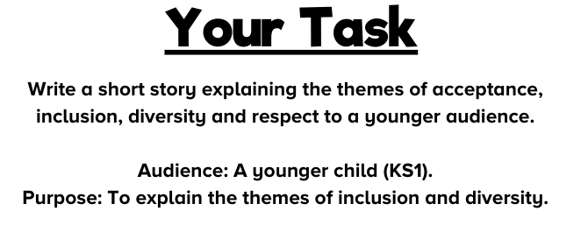
How will the audience shape our writing?
How will the purpose shape our writing?

Slide 61
How will the audience shape our writing?
Simple language choices
Simple plot line
Fun/cute characters
Repetition
Include simple speech/dialogue (which could be read aloud in different voices)
Make the point of the story clear
Not too long
Could include pictures to go along with the words

Slide 62
How will the purpose shape our writing?
Plot needs to be easy to follow
Message of the story needs to be clear
Use the feelings of the characters to help the audience to empathise
Break the story into chunks so that an adult could stop and ask questions to the children at regular points e.g. "How do you think the character is feeling? Why?"

Slide 63
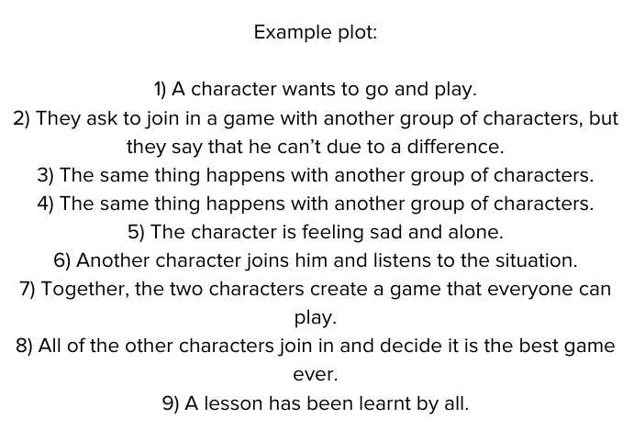
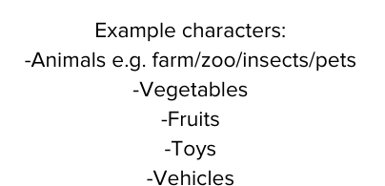
How could we use these ideas to help us to teach younger children about diversity and inclusion?

Slide 64
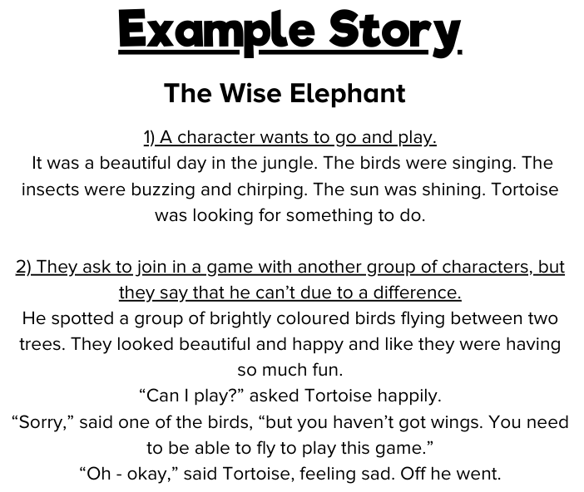

Slide 65
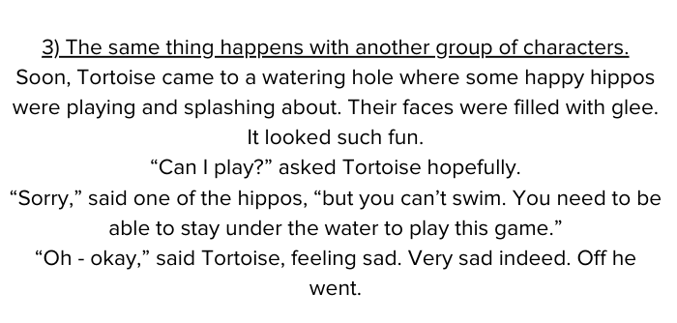

Slide 66
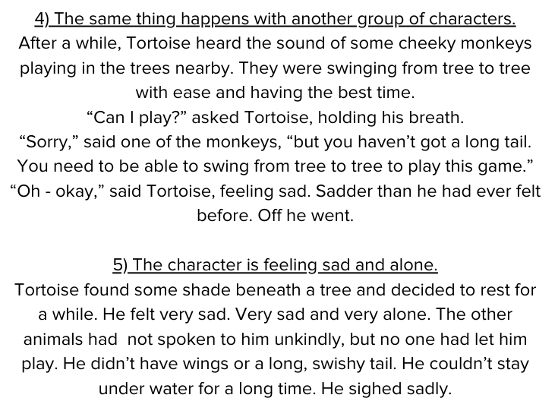

Slide 67
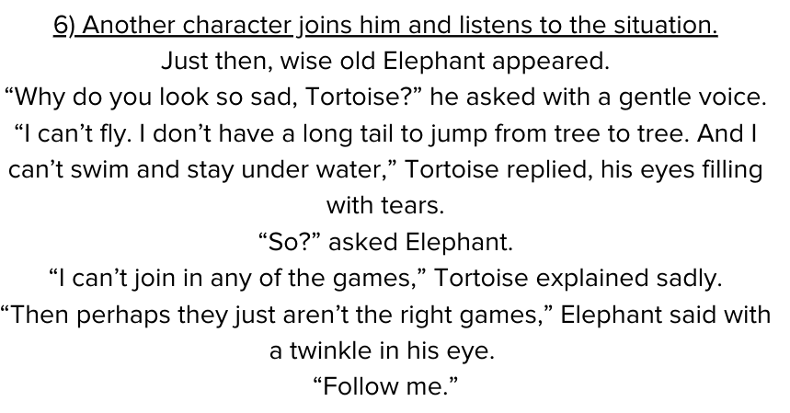

Slide 68
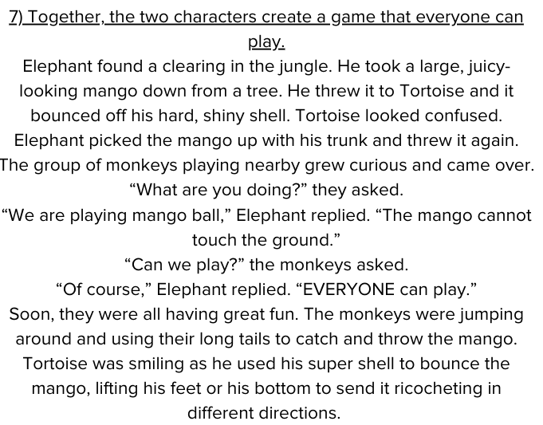

Slide 69
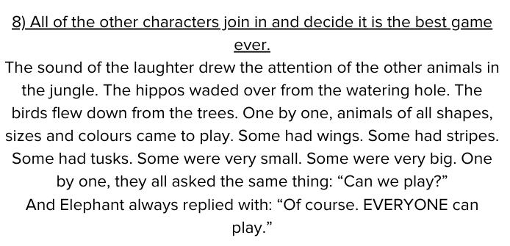

Slide 70


Slide 71


Slide 72
Let's rehearse our stories orally before we begin writing. Tell your story to another person in the class. Remember to use your reading fluency skills to make the story exciting and engaging!

Slide 73
It is time to edit and revise your stories.
Edit:
Are there any spelling errors?
Can you find any errors with punctuation? Look for any examples of missing punctuation or examples of punctuation used incorrectly.
Are there any grammatical errors? Check that your writing makes sense. Check for errors or inconsistencies with tense and person.
Revise:
Check: Does your story meet the intended purpose? Do you need to add/change/remove anything?
Check: Is your story suitable for the intended audience? Do you need to add/change/remove anything?
Are you happy with the content? Can you make any improvements?
Are you happy with your vocabulary choices? Can you make any improvements?

Slide 74
Task Two

Slide 75

What do these words mean?
Why are these themes so important?
Can you give any examples?

Slide 76


Slide 77

What is the purpose of each letter?

Slide 78

Who is the audience for each letter?

Slide 79

What would be the best formality and tone for each letter?

Slide 80

Which letters would be persuasive?

Slide 81
It is time to plan and then write your letters.
You may wish to make some notes as a plan before you begin writing. Consider the following:
Purpose: What do you want your letter to do? Persuade? Inform? Explain? Entertain?
Audience: Who are you writing to? How will this affect your writing?
Tone/Formality: What kind of tone are you using? Are you writing a formal or informal letter?
Introduction: Set out who you are (greeting) and your purpose for writing (intent).
Main paragraphs: Decide on your key ideas and a theme for each paragraph.
Conclusion: Conclude your writing by summarising your main ideas/points.

Slide 82
It is time to edit and revise your letters.
Edit:
Are there any spelling errors?
Can you find any errors with punctuation? Look for any examples of missing punctuation or examples of punctuation used incorrectly.
Are there any grammatical errors? Check that your writing makes sense. Check for errors or inconsistencies with tense and person.
Revise:
Check: Does your letter meet the intended purpose? Do you need to add/change/remove anything?
Check: Is your letter suitable for the intended audience? Do you need to add/change/remove anything?
Check: Are you happy with your tone and formality? Do you need to add/change/remove anything?
Are you happy with the content? Can you make any improvements?
Are you happy with your vocabulary choices? Can you make any improvements?

Slide 83
Art

Slide 84
Task One

Slide 85
Why is difference good?
How is difference beautiful?
What would art be like without difference?
What would life be like without difference?

Slide 86


Slide 87


Slide 88



Slide 89


You could come up with your own wording inspired by all of the themes that we have explored in our learning.

Slide 90


You could find and use an inspirational
quote linked to the themes we have been exploring.

Slide 91
Task Two

Slide 92

What words can you think of linked to the themes that we have been exploring?

Slide 93



Slide 94
Music

Slide 95

Can you think of any songs that you know that are linked to any of these themes?

Slide 96

Why are songs good for making people think or feel a certain way?

Slide 97


If you would like to, you can use some of these words or ideas to get you started.

Slide 98

Why is this important?

Slide 99
Research
Task

Slide 100


Can you think of any people whose lives are/were linked to these themes?

