Slide 1
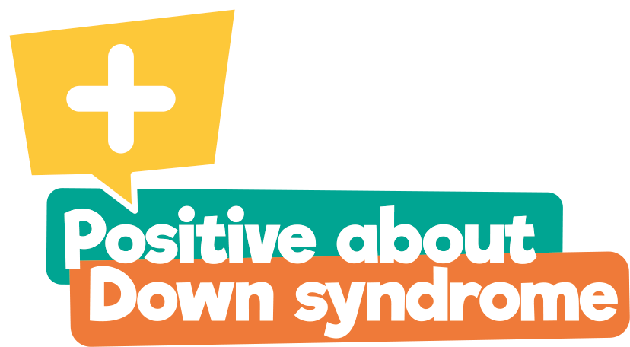

This assembly presentation has been created by Down Syndrome UK, registered charity number 1184564.
It is available for general use but would ask that if a school has a member(s) who has/have Down syndrome, or there are close relatives of a young person with Down syndrome,
that you seek permission of the parents/carers first.
We hope you find this presentation informative and insightful.
We would welcome your feedback: info@downsyndromeuk.co.uk.
Please note that this presentation contains links to YouTube
So please ensure you can access beforehand.
For more information about Down Syndrome UK, please visit our website
www.downsyndromeuk.co.uk.

Slide 2
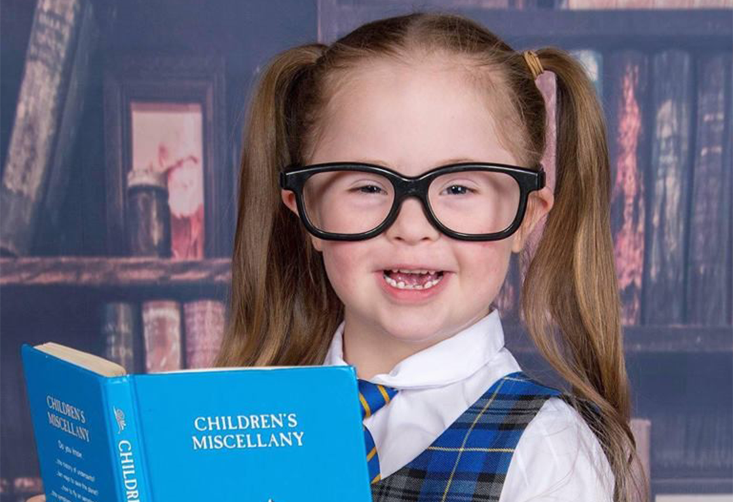
Celebrating Down syndrome!

Slide 3
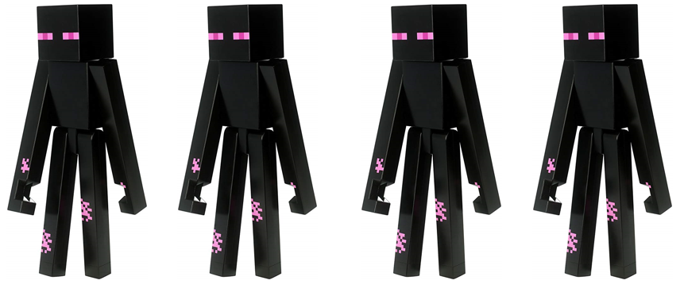
Imagine how strange it would be if you came to school one morning and everyone looked exactly the same – like robots or Enderman from ‘Minecraft’. You wouldn’t be able to tell who your friends were and who was your teacher.

Slide 4
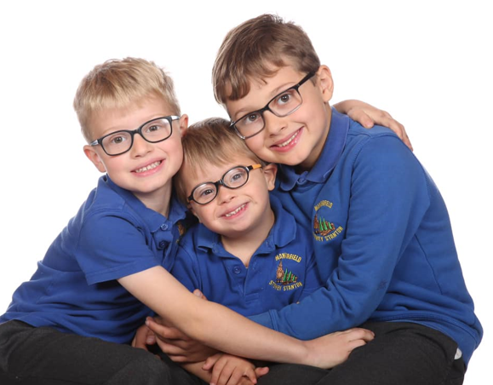
Luckily, each one of us is different;
we are unique, even if we look a little like a brother or sister, or share likes and dislikes with our friends.

Slide 5
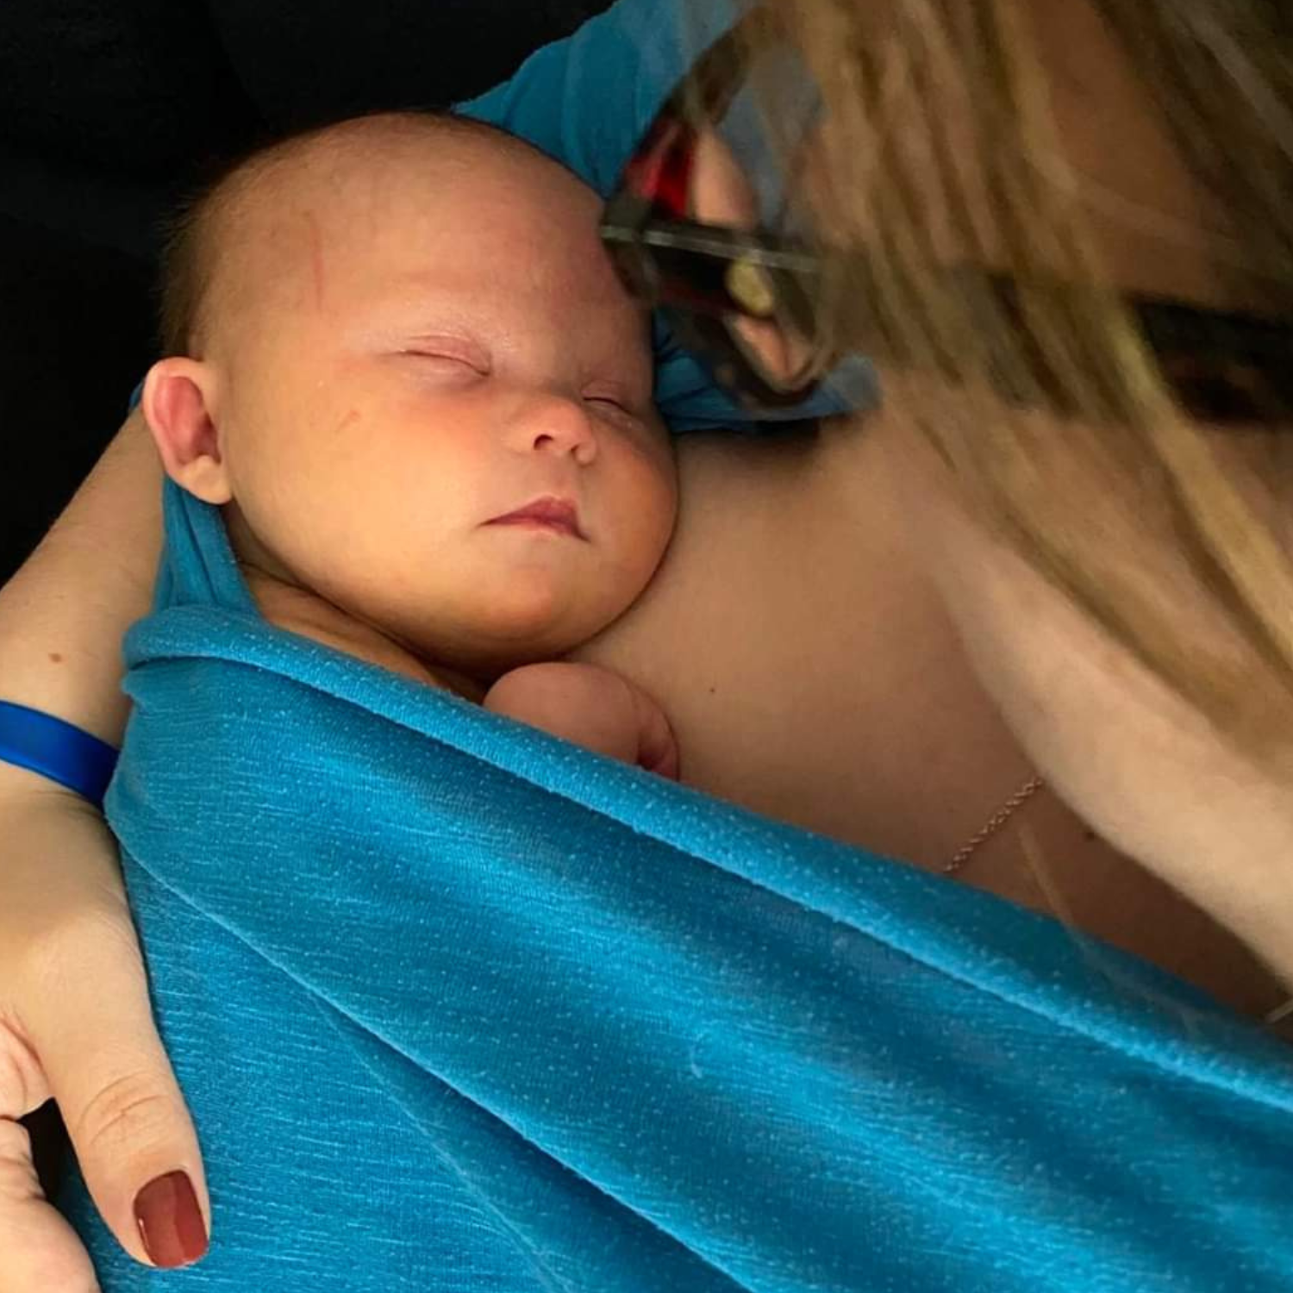
What is Down syndrome?
Babies are born with Down syndrome and will always have it.

Slide 6
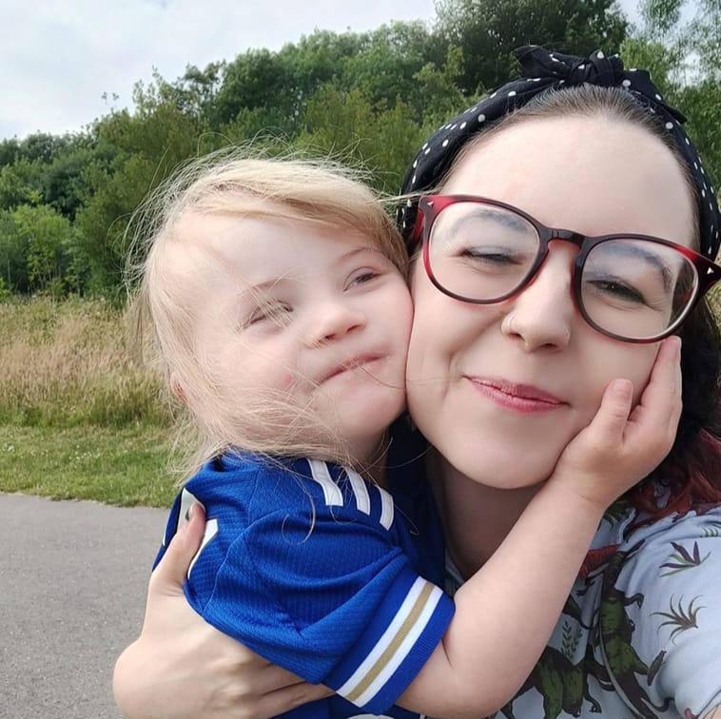
Down syndrome is not an illness.
You cannot catch it like a cold.

Slide 7
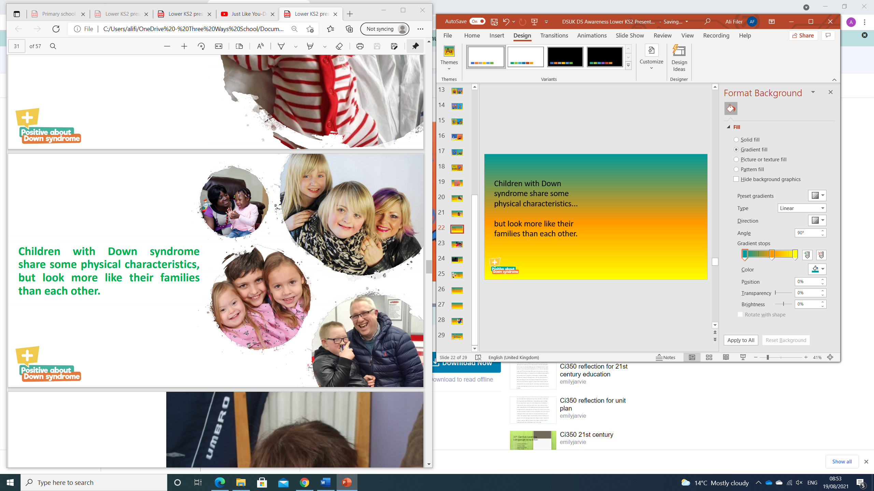
Children with Down syndrome share some physical characteristics... but look more like their families than each other.

Slide 8
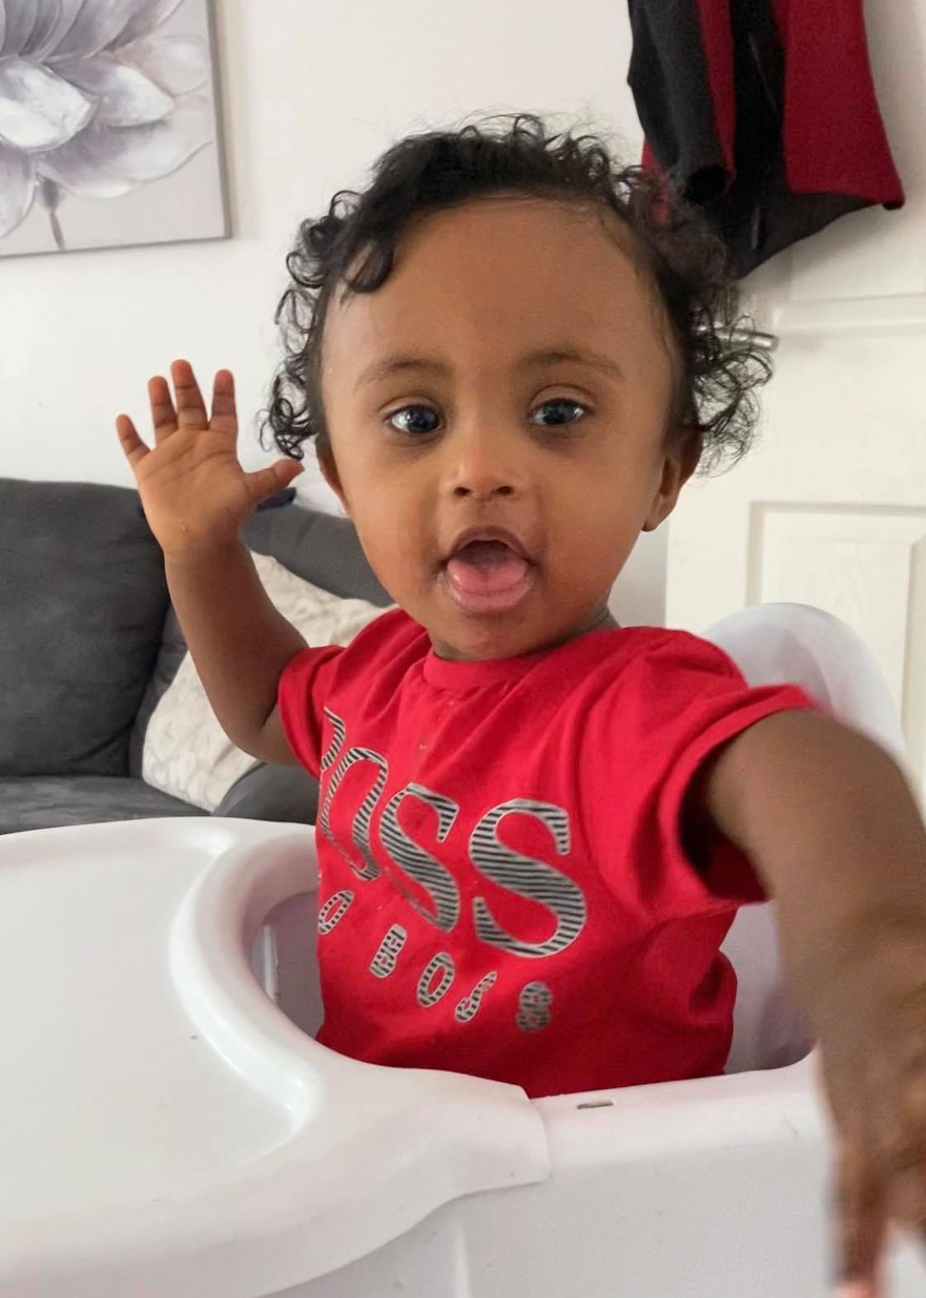
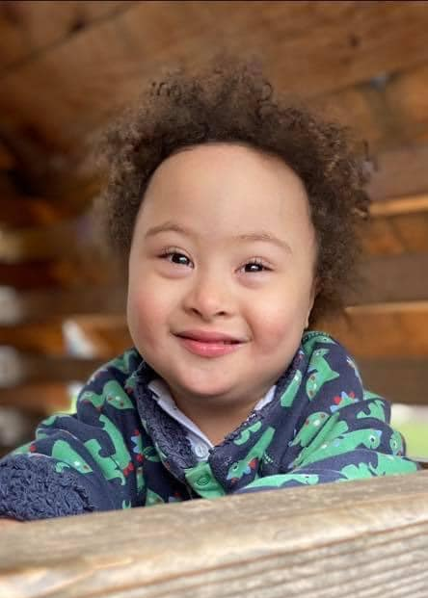
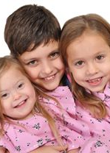
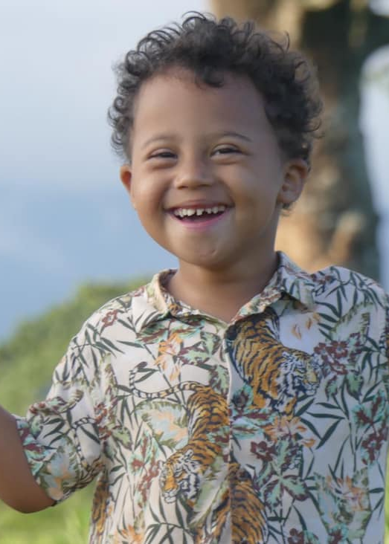
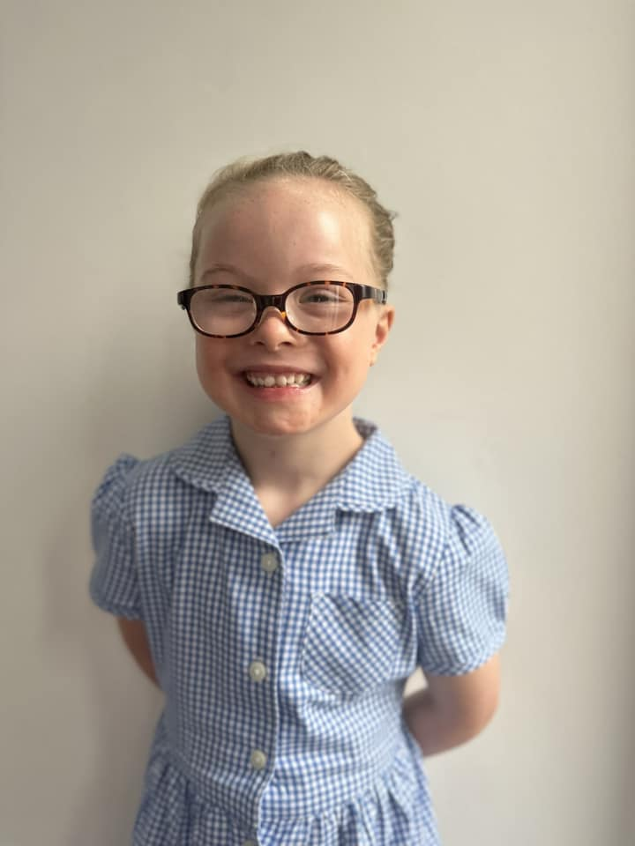
There are people with Down syndrome all over the world.

Slide 9
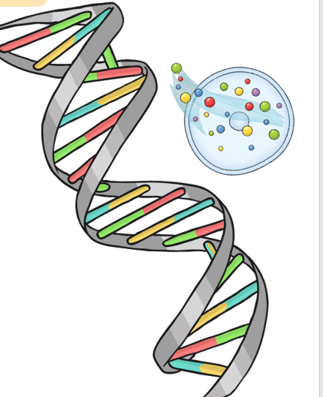
What causes
Down Syndrome?
Chromosomes!
These are tiny thread-like structures inside our cells.
Everyone has them, in fact most people have 23 pairs (46 altogether) in every cell and we have a lot of cells!

Slide 10
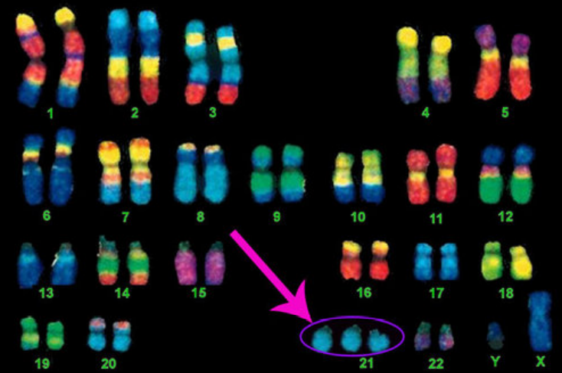
Chromo - what? …Chromosomes!
These chromosomes are important as they decide if we will be male or female, what we look like and lots of other really important things.
A person with Down syndrome is born with an extra chromosome in every cell.
So, instead of 46 individual chromosomes (23 pairs), they have 47.

Slide 11
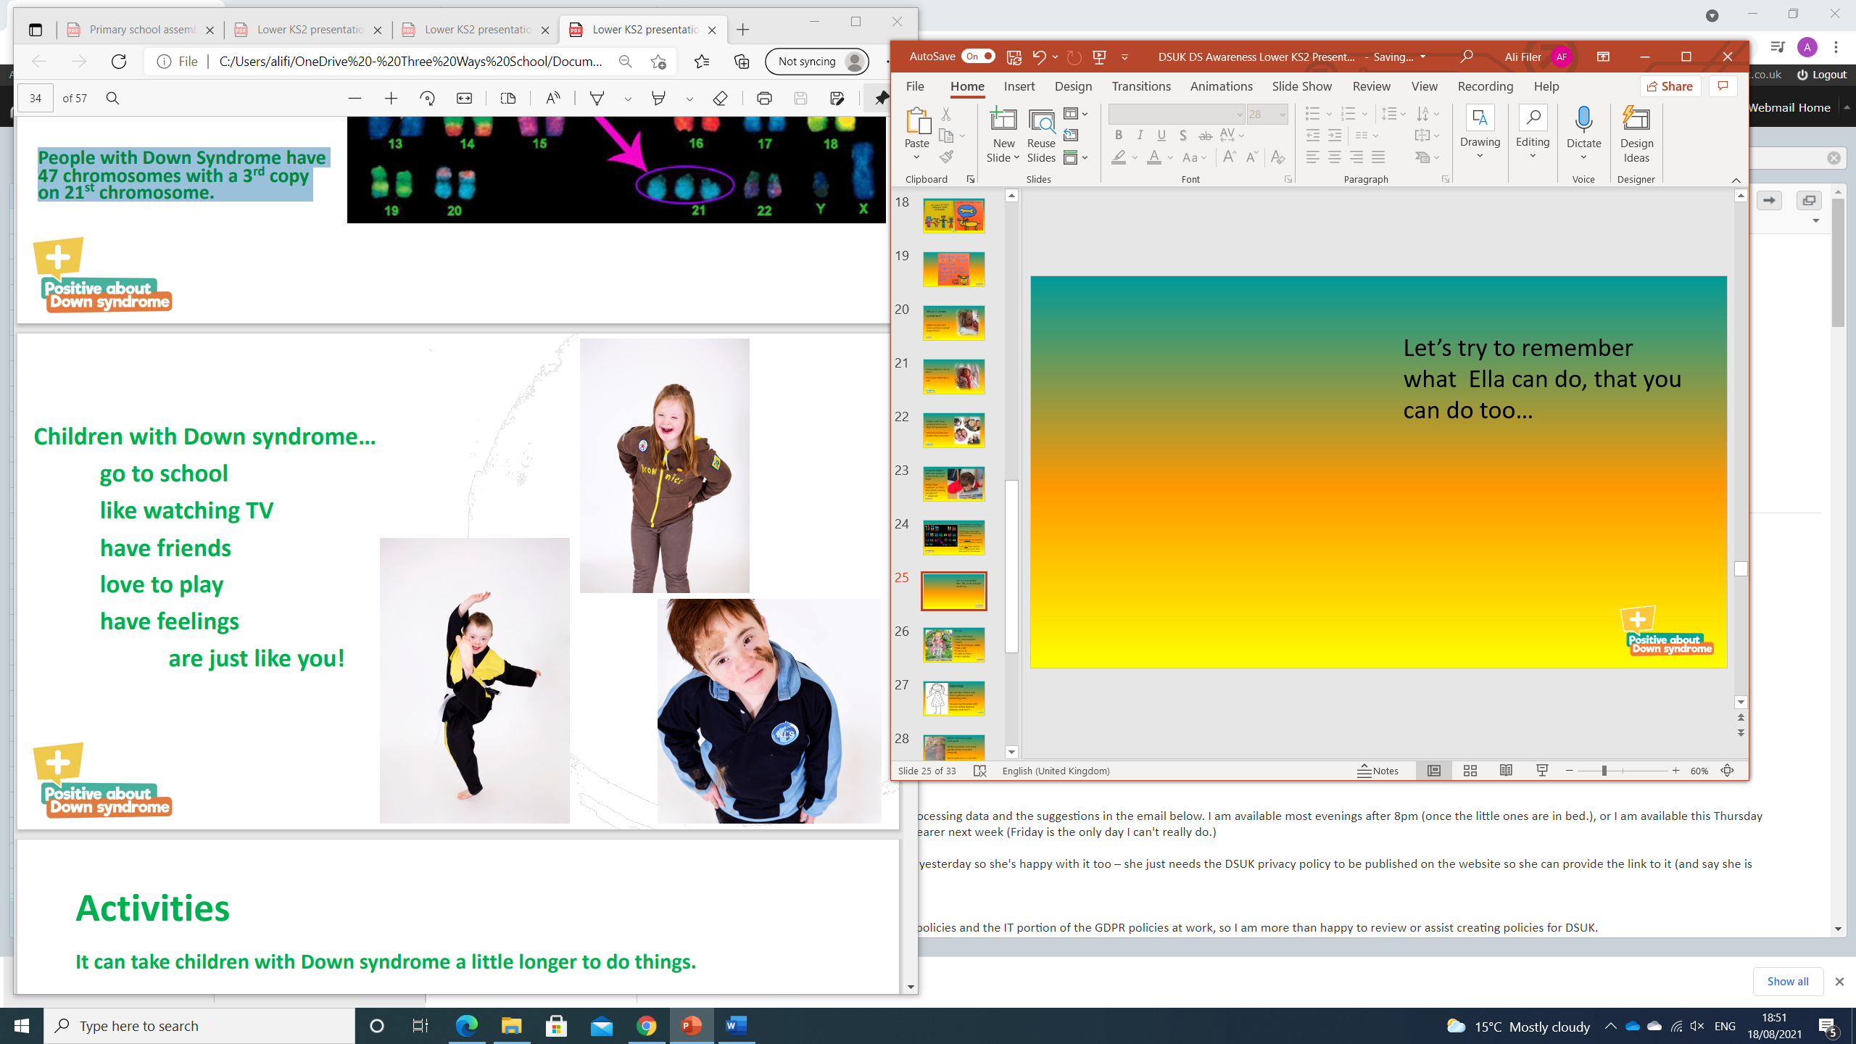
Children with Down syndrome...
go to school
like watching TV
have friends
love to play
have feelings
and are just like you!

Slide 12
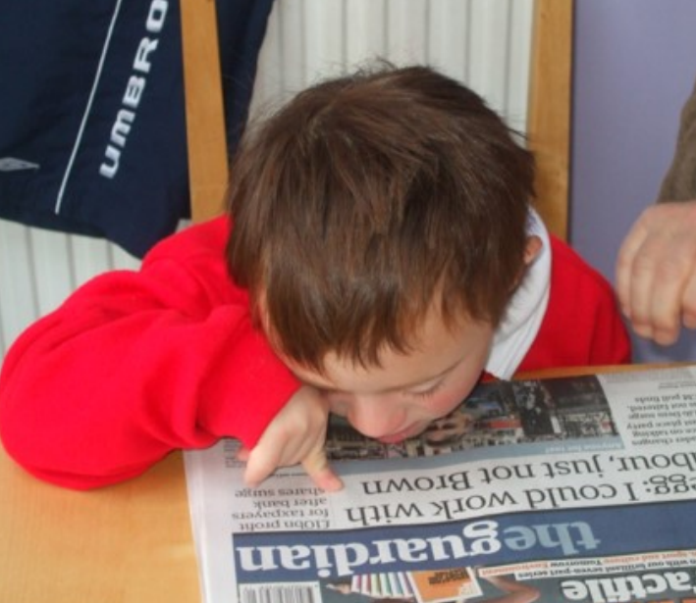
Finding some things tricky
Having Down syndrome means that you can find things like speaking, remembering and understanding more difficult.
Children with Down syndrome will learn to read and write, it might take them longer and be harder work for them.

Slide 13
Chloe explains Down syndrome - YouTube

Slide 14
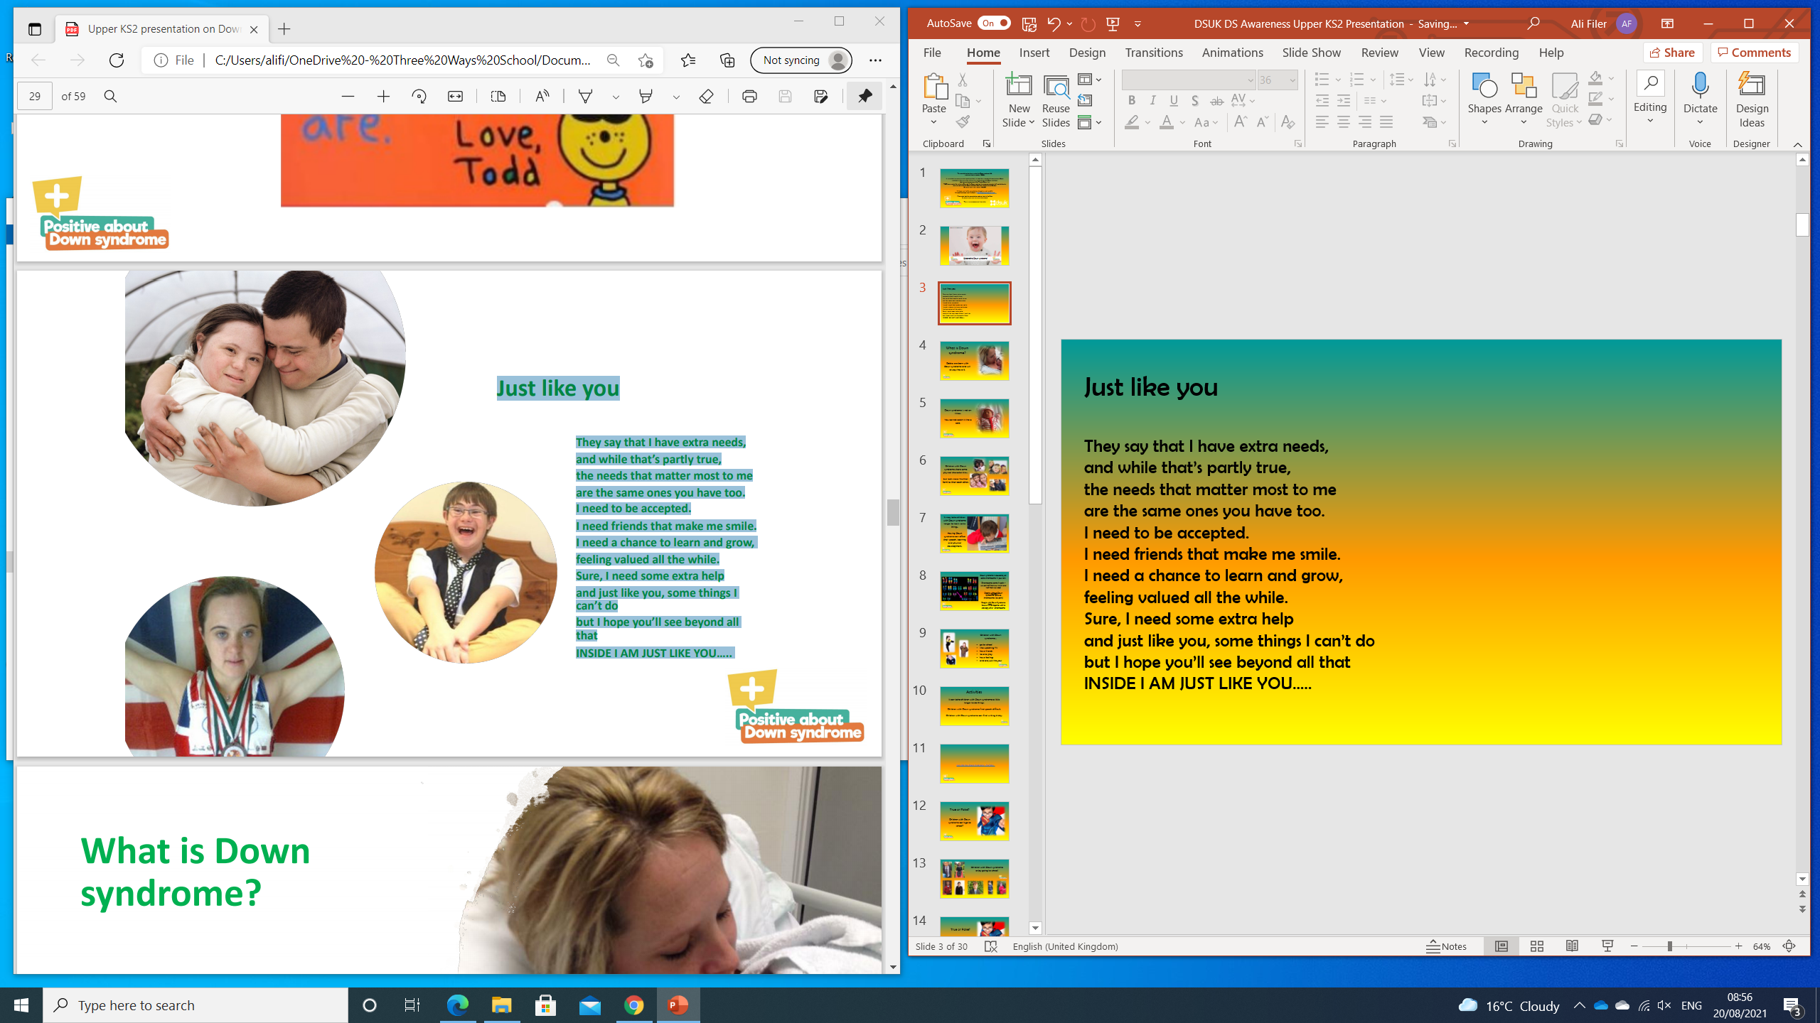
Just like you...
They say that I have extra needs,
and while that’s partly true,
the needs that matter most to me
are the same ones you have too.
I need to be accepted.
I need friends that make me smile.
I need a chance to learn and grow,
feeling valued all the while.
Sure, I need some extra help
and just like you, some things I can’t do
but I hope you’ll see beyond all that
INSIDE I AM JUST LIKE YOU…..

Slide 15
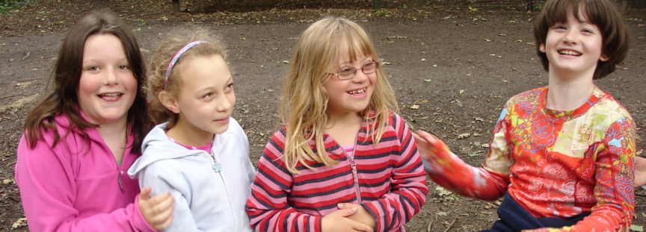
Reflection - more alike than different
Are you the same as the person next to you?
Everyone in this room is different from each other
Everyone in the world is different from each other
When a person has Down syndrome, it is just one small part of who they are
Being a good friend to someone else is the same no matter who they are.

Slide 16

World Down Syndrome Day
The 21st day of March (the 3rd month of the year) was selected to signify the uniqueness of the triplication (trisomy) of the 21st chromosome which causes Down syndrome.
Every year on March 21st, World Down Syndrome Day is observed to create awareness about Down syndrome.

Slide 17
The Hiring Chain performed by STING - YouTube

Slide 18
www.downsyndromeuk.co.uk
© 2024 Positive about Down Syndrome | A DSUK initiative
All rights reserved | Registered Charity Number 1184564
Thank you for watching!

