Slide 1


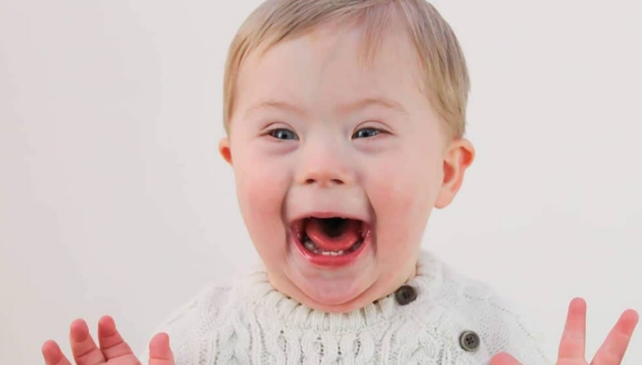


Key Stage 2 Upper
Down syndrome
awareness presentation

Slide 2
Introduction
This presentation has been created by Down syndrome UK, registered charity number 1184564.
It is available for general use but would ask that if a school has a member(s) who has/have Down syndrome, or there are close relatives of a young person with Down syndrome, that you seek permission of the Parents/Carers first.
We hope you find this presentation informative and insightful and welcome your feedback: info@downsyndromeuk.co.uk
Please note that this presentation contains links to YouTube, so please ensure you can access beforehand. There is an accompanying lesson plan.

Slide 3
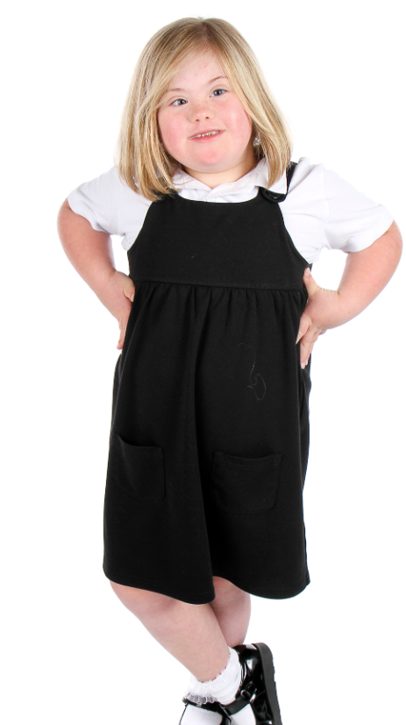

Just like you
They say that I have extra needs,
and while that’s partly true,
the needs that matter most to me
are the same ones you have too.
I need to be accepted.
I need friends that make me smile.
I need a chance to learn and grow,
feeling valued all the while.
Sure, I need some extra help
and just like you, some things I can’t do
but I hope you’ll see beyond all that
INSIDE I AM JUST LIKE YOU…..
Chloe explains Down syndrome

Slide 4
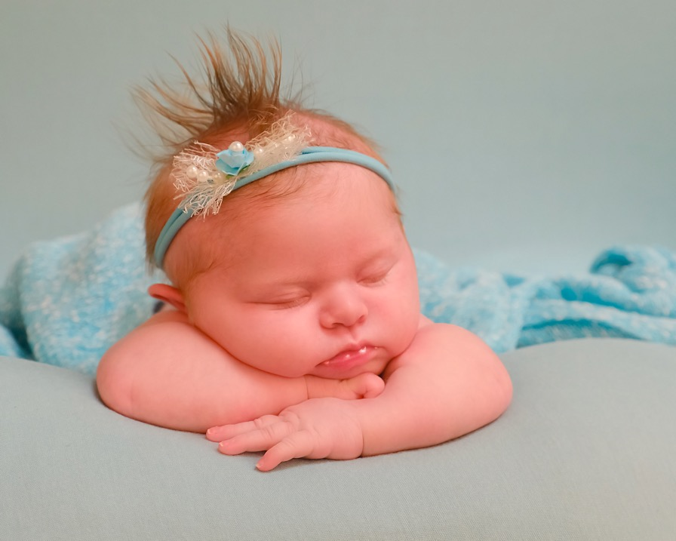
What is Down syndrome?
Babies are born with Down syndrome and will always have it.

Slide 5
Down syndrome is not an illness.
You cannot catch it like a cold.

Slide 6
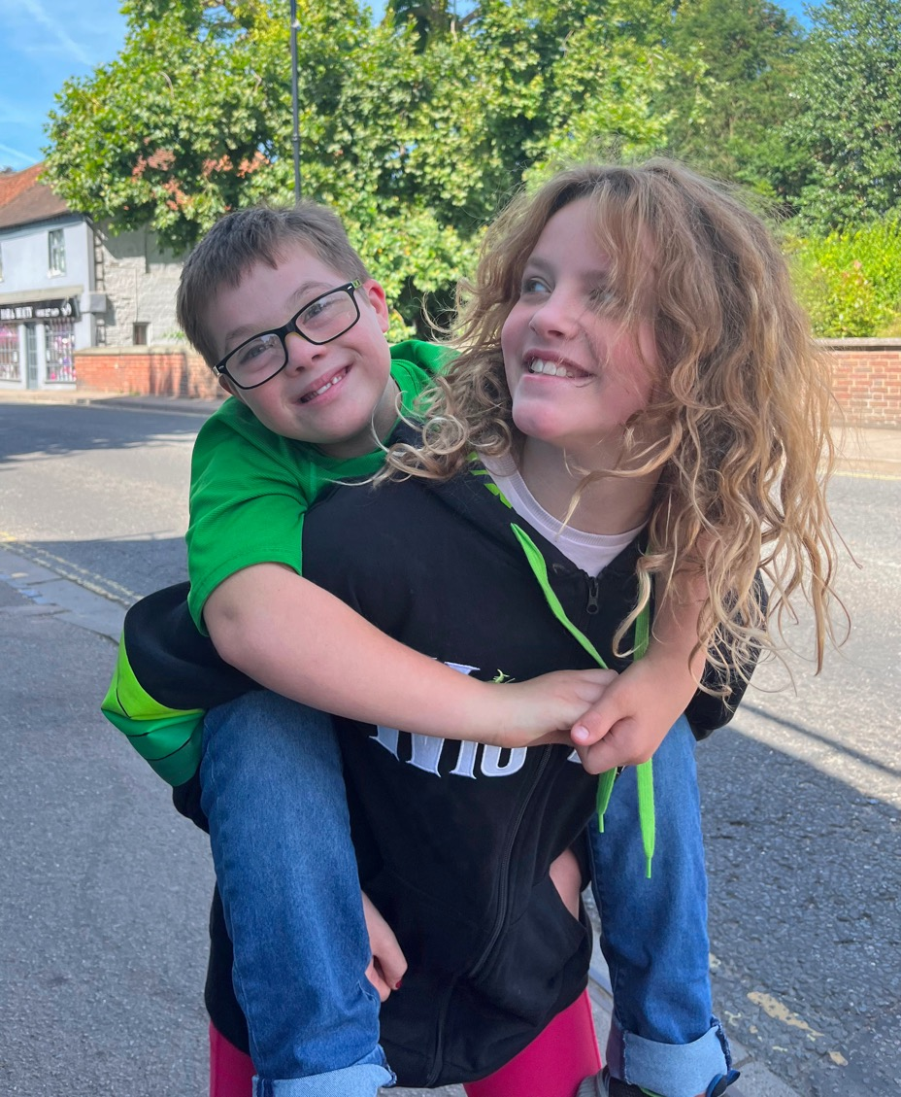
Children with Down syndrome share some physical characteristics... but look more like their families than each other.

Slide 7
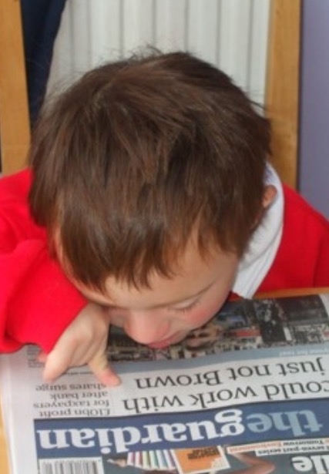
It may take children with Down syndrome longer to learn some things.
Having Down syndrome can affect their speech, learning and physical development.

Slide 8
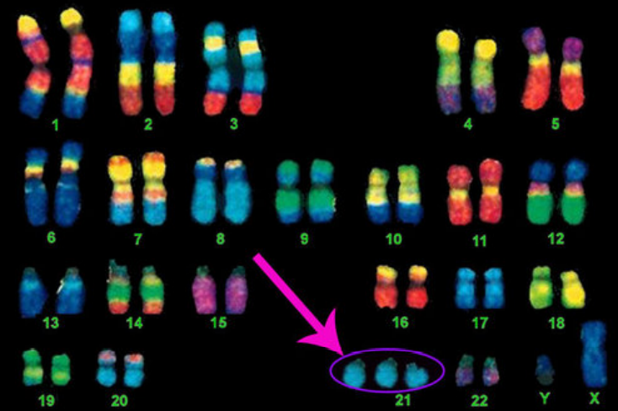
Down syndrome is caused by an extra chromosome in your cells
Chromosomes come in pairs - we get half from our mum and half from our dad
People without Down Syndrome have 46 chromosomes (23 pairs)
People with Down Syndrome have 47 chromosomes with a 3rd copy of 21st Chromosome

Slide 9
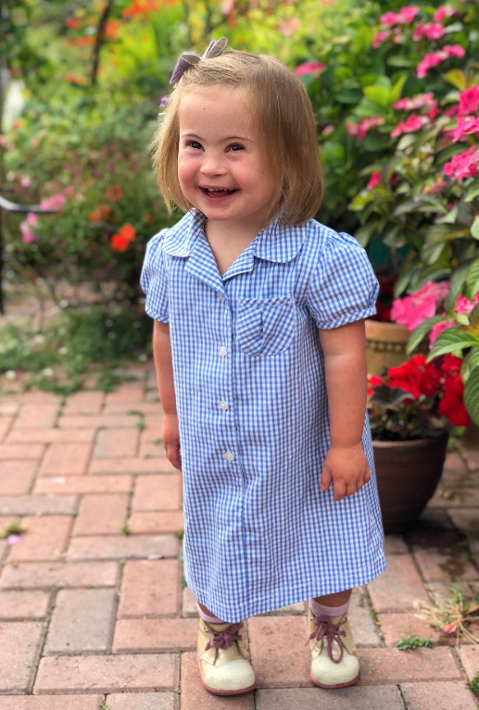
Children with
Down syndrome
go to school
like watching TV
have friends
love to play
have feelings and are just like you!

Slide 10
Activity
Children with Down syndrome
can find speech difficult.

Slide 11
Activity - Dictoglass

Slide 12
Facts about Down syndrome
Did you know that your body is made up of billions of cells, which are too small to see without a strong microscope?
Inside most of those cells are chromosomes, which are thread-like strands. These carry the plan which tells our bodies how to grow.
Chromosomes come in pairs - we get half from our mum, half from our dad.
People without Down Syndrome have 46 chromosomes (23 pairs).
Down syndrome is caused by an extra chromosome in your cells – there is a 3rd copy on 21st chromosome. So, people with Down syndrome have 47 chromosomes.

Slide 13
Facts about Down syndrome
Sometimes people with Down syndrome learn in a different way and their bodies sometimes work differently too.
People with Down syndrome are good at some things and have to work really hard at others. They can play, dance, learn, get a job and live on their own – just like you.
People with Down syndrome are different from you in some ways but are like you in many ways too.

Slide 14
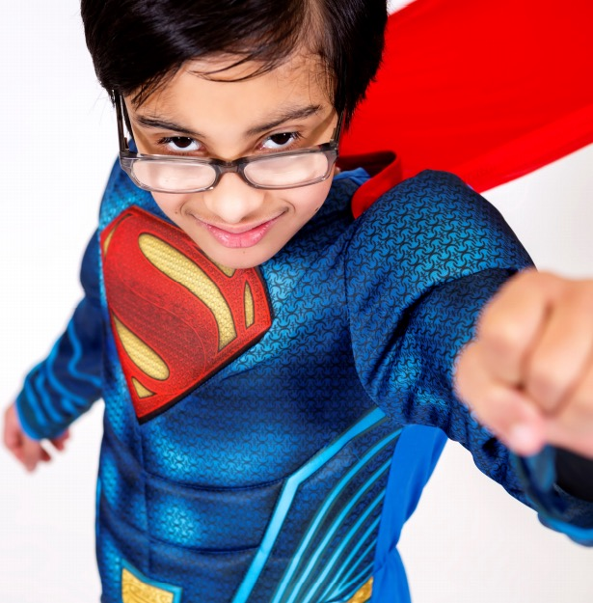
True or false?
Children with Down syndrome can’t go to school?

Slide 15
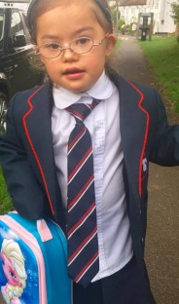
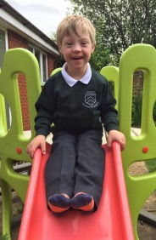
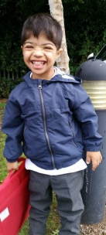
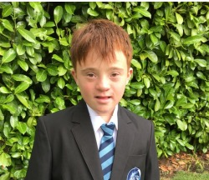
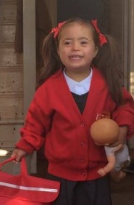
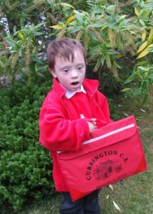
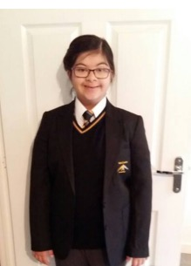
False
Children with Down syndrome enjoy going to school!

Slide 16
True or false?
Children with Down syndrome are always happy?

Slide 17
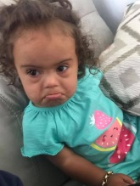
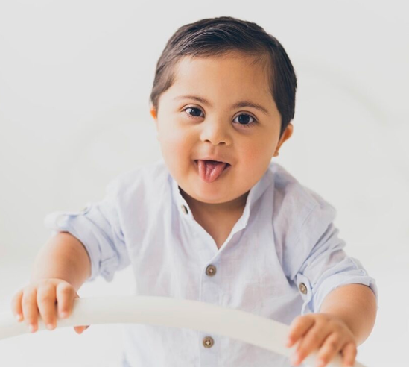
False
Children with Down syndrome experience all emotions - just like you do!

Slide 18
True or false?
Children with Down syndrome can get a job.

Slide 19
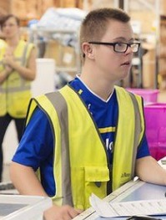
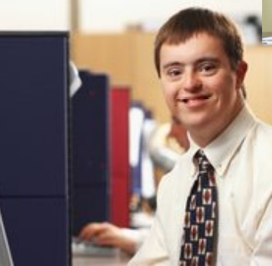
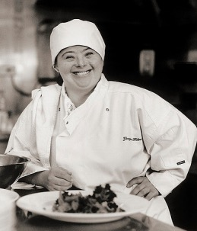
Absolutely!
Young people with Down syndrome enjoy working!

Slide 20
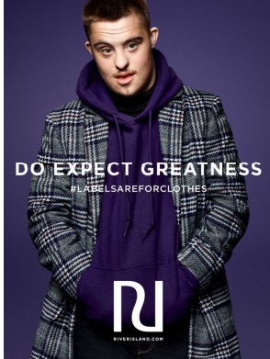
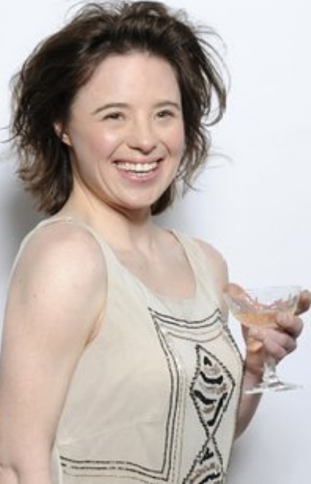
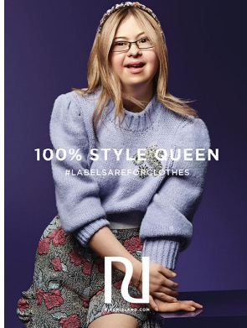
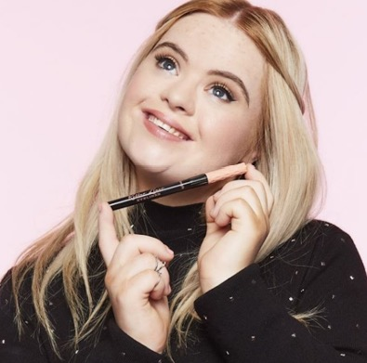
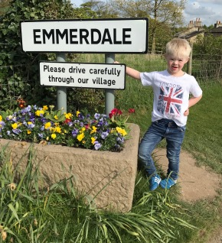
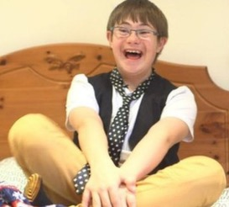
Young people with
Down syndrome enjoy acting and modelling too!

Slide 21
True or false?
Can people with Down syndrome get married?

Slide 22
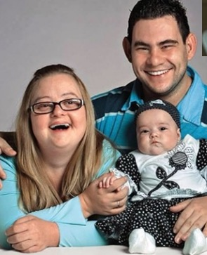
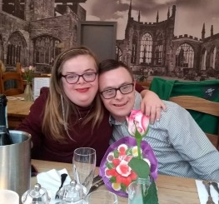
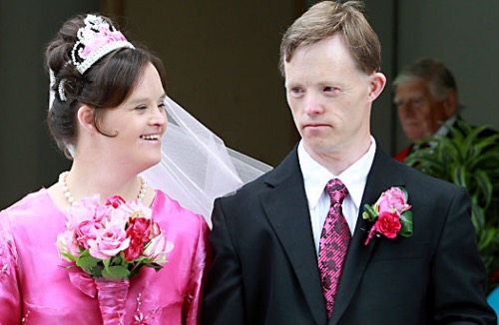
Yes, they can!
Young people with
Down syndrome enjoy relationships.

Slide 23
True or false?
People with Down syndrome can’t play sports?

Slide 24
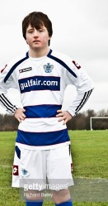
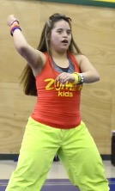
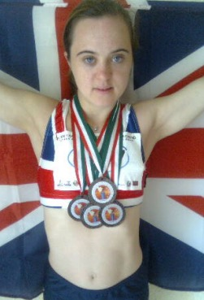
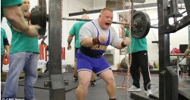
False!
Young people with Down syndrome enjoy sports.

Slide 25
True or false?
People with Down syndrome can’t drive?

Slide 26
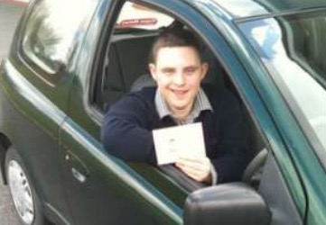
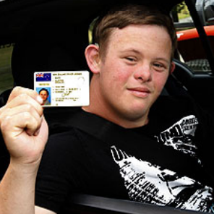
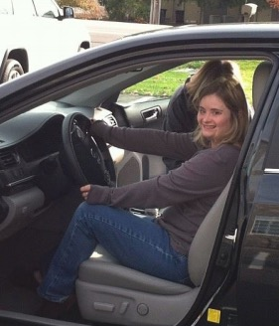
Yes, they can!
Young people with Down syndrome enjoy getting about.

Slide 27
True or false?
People with Down syndrome like the same things as other children?

Slide 28

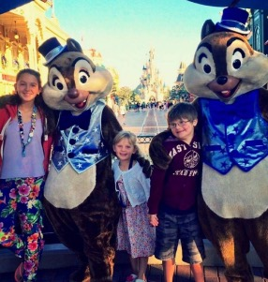
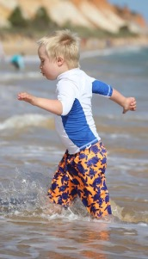
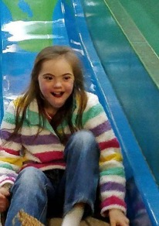
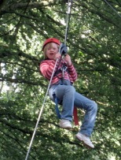

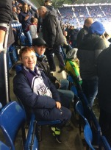
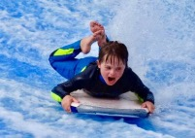
Absolutely!
Children with
Down syndrome enjoy the same things as you.

Slide 29
‘The Hiring Chain’ performed by Sting
https://youtu.be/SKku4RAWa4M

Slide 30
What have we learnt about people with Down syndrome?

Slide 31

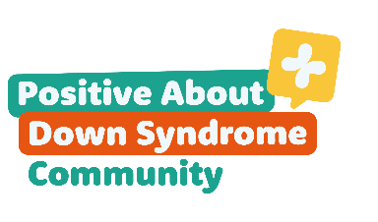








For more information visit: www.downsyndromeuk.co.uk

